Slide 1
How do you know where to begin?
Using Informal Assessments and Data
to Determine Job Readiness

Slide 2
Who’s in the room?
Notes:
ESC Transition Specialists? TEDs? Classroom Teachers? SPED Administrators? Universities?
Any first year teachers or first year TEDs?
Anyone with 15 years experience? 20?
Anyone who has worked as a VR counselor or other adult service provider?

Slide 3
Overview
This session is designed to help you gather information to determine students’ readiness for Pre-ETS instruction and work experience. It is intended to address the specific needs identified in the Capacity-Building Project’s focus groups, conference work sessions, and participant feedback.

Slide 4
This session is NOT a guide for overall transition assessment and planning.
Your ESC transition specialists, TEA, and state experts like Brynn Biggs are your best resources for compliance questions and questions in general.
This session will focus on gathering the information you need to determine students’ Pre-ETS needs, address readiness skills in the classroom, and coordinate services with your VR counselor.

Slide 5
First, let’s define terms: Pre-ETS stands for Pre-Employment Transition Services
These services are defined in the Workforce Innovation and Opportunities Act (WIOA), and they include 5 skill areas:
Self Advocacy
Career Exploration
Workplace Readiness
Counseling on Post-Secondary Education Opportunities
Work-Based Learning
Educators use a variety of terms for these skills, but you’ll hear VR Counselors and other TWC staff refer to them as Pre-ETS.

Slide 6
TWC and other state VR agencies are required by WIOA to set aside at least 15% of their budgets for Pre-ETS services for customers who:
Are ages 14 - 22
Are still in school
Have a documented disability (including students served under 504 plans)

Slide 7
According to IDEA, the purpose of special education is to provide a free and appropriate public education that emphasizes special education and related services designed to meet students’ unique needs and to prepare them for further education, employment, and independent living.
Meeting students’ Pre-ETS needs is the culmination of our IDEA mandate.

Slide 8
But providing these services at school can be challenging.
Finding time in their schedules
Staff shortages
Competing priorities
Parent engagement
Lack of disability awareness
Providing career exploration
Managing CBVI
Supporting success in CTE
Providing meaningful work experience
That’s why service coordination with TWC is so important.

Slide 9
Common TWC Pre-ETS Service Delivery Models
One-on-one counseling
Pre-ETS classes during the school day
After school or summer group skills training
Summer camps
University-based programs like TAMU’s WACO Project and UNT’s College Wise
Online training
Summer Earn and Learn
Paid Work Experience
Explore Apprenticeships
Project SEARCH

Slide 10
Assess
Students’ needs for Pre-ETS
Like any other instructional area, Pre-ETS instruction follows a cycle of assessment, direct instruction, and application.
Support
Provide
Real-World Experience & Practical Application
Direct Instruction & Repeated Practice

Slide 11
Assessment is the foundation of service coordination.
If students aren’t aware of their disabilities and how they affect employment, they may decline services.
Assessment of career awareness helps students set realistic career goals, guiding their TWC services.
Informal assessment identifies subtle skill gaps.
It helps us scaffold skills and avoid competing demands.
Assessment ensures students are ready for internships,SEAL or Paid Work Experience.
Assessment identifies the need for job coaching, accommodations, or other workplace supports.

Slide 12
What data do you already have?
Formal Assessment:
Achievement testing
Adaptive scales like the Vineland or the ABAS
Speech and language evaluation
Assistive technology assessment
Executive function evals like the BRIEF
Formal transition assessments like the TAGG, TPI-3, or Transition Behavior Scale

Slide 13
What data do you already have?
Informal Assessment:
AIR Self-Determination Assessment
Employability Life Skills Assessment
Casey Life Skills Assessment
Life Skills Inventory
Assistive Technology Protocol for Transition
ARC Self-Determination Scale

Slide 14
What other data do you already have?
Informal Sources:
PLAAFP and progress reports
504 Plan
FBA and BIP
Student and family input
Teacher, para, and therapist input
Classroom or workplace observations
What other sources can you think of?

Slide 15
Comprehensive Assessment and Planning for the IPE
"Includes an evaluation of the customer's unique strengths, resources, priorities, concerns, abilities, capabilities, interests, and informed choice—including the need for supported employment."
Notes:
Which of these do we tend to neglect? How can we gather that information and share it with the VR Counselor?

Slide 16
Assessment Considerations for College-Bound Students (p. 32-33)
TWC may review the FIE, EOCs, transcript and/or TSIA to determine appropriateness of college services.
Whenever possible, provide current testing, not a REED.
If testing isn’t current, the student may be required to pay for any updated eval.
TWC can only pay for 2 semesters of developmental courses
Students must:
Attend school full time, usually a minimum of 12 semester hours
Apply for the Pell Grant- any money received is then applied toward tuition and books before TWC-VR payment.
Maintain at least a 2.0 GPA
Flag these students for early referral to TWC

Slide 17
Choosing and Using Informal Assessments

Slide 18
What is informal assessment, and how can it help us?
Formal assessments are standardized instruments with specific administration guidelines that have been proven reliable and valid, and that have been normed for different ages and populations.
Informal assessments don’t meet these criteria, but they can provide a wealth of information. They are generally faster, easier, and more flexible assessment tools.

Slide 19
Common Types of Informal Assessments
Work Samples
Student portfolios
Class projects
Video resumes
Observations
Classroom
Community
Workplace
Interviews
Student
Family
Teachers
Direct Assessment
Online tools like O*Net
Curriculum Based Measures like Choicemaker
Student-Centered Approaches
Person-Centered Planning
The Discovery Process
I’m Determined
Notes:
Interview teachers in classes where the student is successful and where they’re struggling. Why are they struggling or flourishing? Interest? Skill gaps? Classroom environment or expectations? Look at the questions in the TWC handout

Slide 20
TWC Resources
Assessing Student Needs (p. 14-18)
Job Readiness Checklist (based on VR 1823, p. 38-39)
Common VR Forms (p. 46-47)

Slide 21
Comprehensive Source of Informal Pre-ETS Data: Transition Tennessee's Pre-ETS Sequencing Guide
Developed by Vanderbilt University for TN Dept of Human Services
Checklist specific to Pre-ETS areas
Provides competency categories for each area
Breaks each competency category into a sequence of skills
Provides skill building activities
Available at https://transitiontn.org/pre-ets-sequencing-guides/ (Free login required)
We’ll use this resource in today’s session on sequencing skills & cascading services.

Slide 22
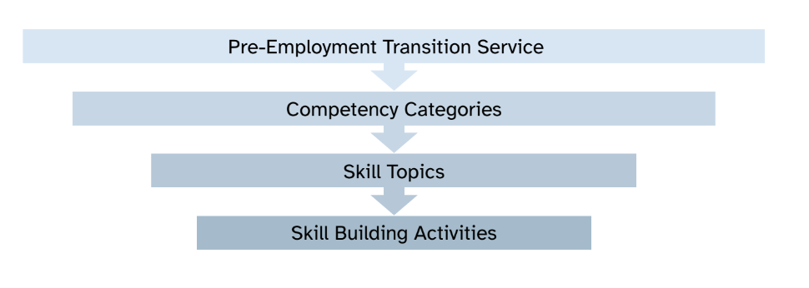
Transition Tennessee’s Pre-ETS Guide:
Assessment Design

Slide 23
Group Activity:
Analyzing Data from the Pre-ETS Sequencing Guide
Review the student profile on page 34 - 37 of your workbook and make recommendations for next steps. Consider:
Is this skill area a priority for this student?
Where do you see crucial skill gaps?
Does the school need to close any gaps before considering Pre-ETS services?
What scores might indicate whether a student is ready for Summer Earn and Learn or Paid Work Experience?
Do any of these skills overlap with other Pre-ETS areas?
What else can you learn from this data?

Slide 24
Share Out

Slide 25
Considerations when reviewing assessment data:
Always review the results with the student.
Share information with the family.
Be aware that transition assessments may reveal a need for assistive technology or related services like in-home and parent training.
Watch for subtle barriers to employment or postsecondary education.

Slide 26
Considerations when reviewing assessment data:
Watch for subtle barriers to employment or postsecondary education.
Disability awareness
Recognizing their strengths, weaknesses, and interests
Work stamina
Self-regulation
Following directions and accepting constructive feedback
Ability to work with unfamiliar peers and adults
Compliance with hygiene and safety routines
Ability to accept responsibility for their actions

Slide 27
Looking for Assessment Tools?
Quick reference on p. 32-33
Transition Tennessee’s Assessment Database
NTACT:C’s Collaborative Assessment Guide Tools and Resources
Autism Grown Up’s Transition Assessment Database
Transcen Inc.’s Discovery Process Resources

Slide 28
Questions?
Robin Miller Joette Hardin
robin.miller@tamu.edu jhardin@tamu.edu
Marcy Hancock Jana Bishop
mjhancock.00@tamu.edu janabishop@tamu.edu
cdd.tamu.edu

