Slide 1
Pre-ETS Regional Training Breakout DFW Area
Statewide Capacity Building Conference
Frisco, TX
October 2024
Please make sure you have representation from VR and schools at each table.

Slide 2
Welcome
Rosla Hocker | Carla Johnson | Kevin Markel | Amy Reeves
Texas Workforce Commission | Region 11 Education Service Center | Texas Workforce Commission | Region 10 Education Service Center
Rosla.Hocker@twc.texas.gov | cjohnson@esc11.net | Kevin.Markel@twc.texas.gov | Amy.Reeves@Region10.org
817-420-5821 | 817-740-3614 | 817-727-9045 | 972-348-1754

Slide 3
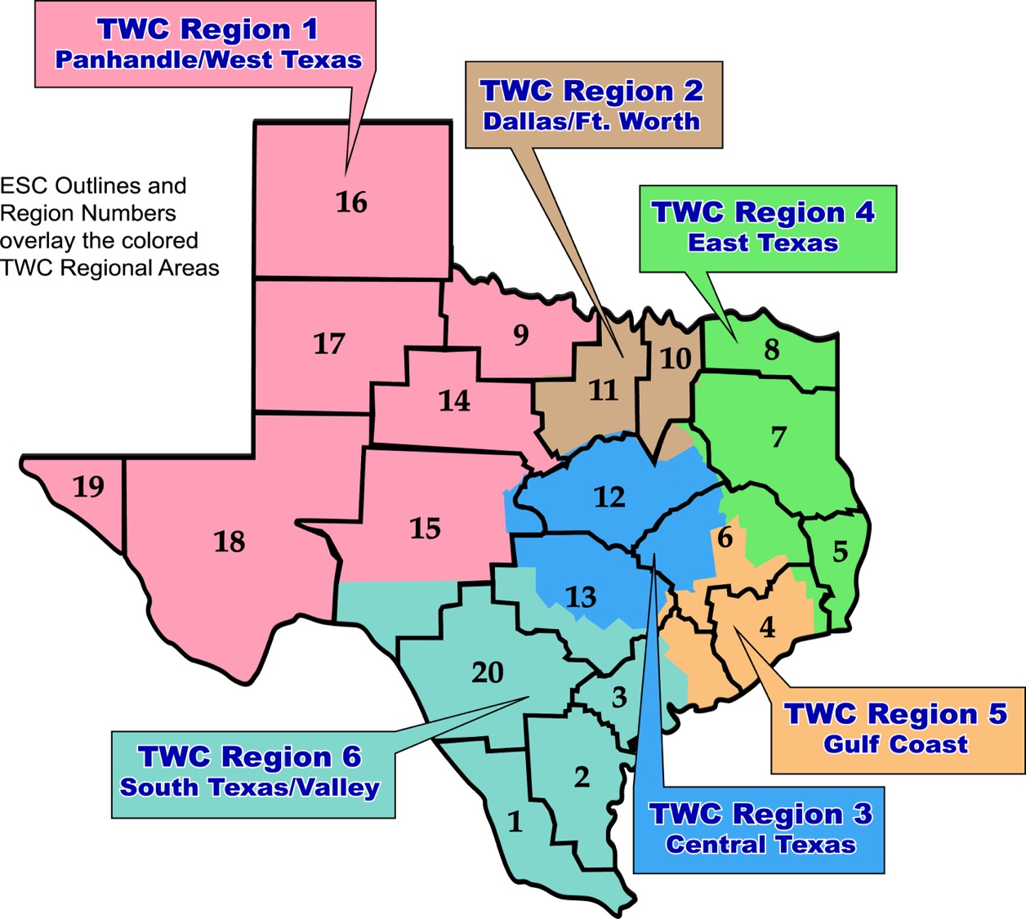
Map of Texas with VR and ESC Regions

Slide 4
Collaboration

Slide 5
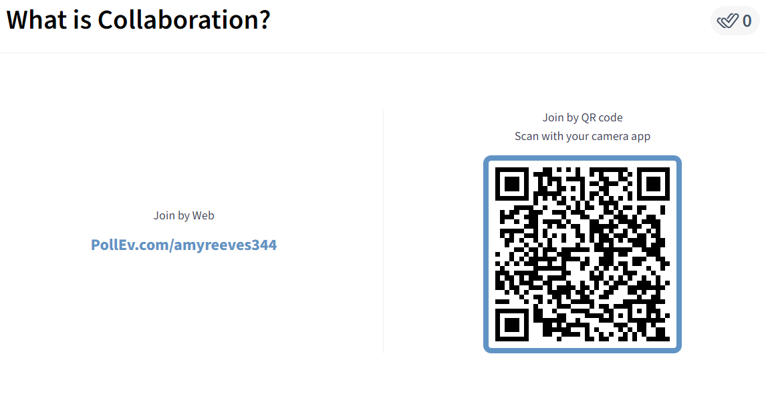
What is Collaboration?

Slide 6
Capacity Building for a Stronger Collaboration
Collaboration and Communication for student success
How systems benefit from seamless transition collaboration
What are Pre-Employment Transition Services (Pre-ETS)
How ISD Staff can initiate contact with VR Staff
Starting the student referral process
Two Pathways to Vocational Rehabilitation Services:
(1) Potentially VR Eligible and (2) VR Eligible
When to enter into each VR Phase?
Review of the Potentially Eligible Process

Slide 7
Importance of Collaboration
Collaboration is a predictor of positive postschool outcomes for students with disabilities when it occurs across education, vocational rehabilitation, families, and numerous other partners who provide instruction, pre-employment transition services, and other transition services stakeholders.
Well-developed partnerships for planning and service delivery give the greatest benefit to youth and their families.
Source: Interagency Collaboration - NTACT:C (transitionta.org)

Slide 8
Seamless Transition Collaboration How Systems Benefit
Education
More meaningful Individual Education Plans (IEP) and transition plans required under the Individuals with Disabilities Education Act (IDEA);
Additional positive outcomes required by IDEA Indicator 14 reports, and post-school follow up shows more former students working.
More meaningful 504 Plans required under the 504 Rehabilitation Act.
Vocational Rehabilitation
Clear opportunities to meet WIOA requirements to collaborate with education agencies;
More successful case closures, that is, services to youth with I/DD and other significant disabilities result in successful employment.
State I/DD and Other Service Agencies
More efficient application of resources when providing services to youth who exit school already working.

Slide 9
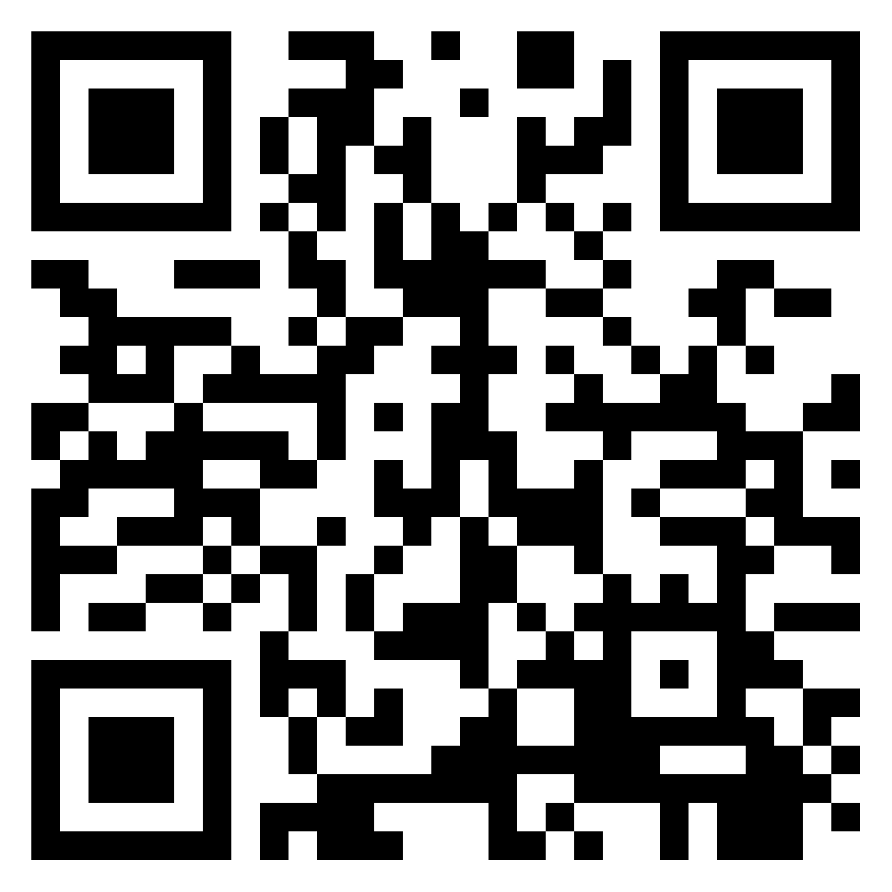
What Could Collaboration Look Like?
https://padlet.com/amyreeves2/Collaboration

Slide 10
Federal Indicators

Slide 11
Alignment Between Indicators 1
VR Performance Indicators 4 & 5
IDEA Part B Indicator 13
Attain a recognized postsecondary credential or secondary school diploma or equivalent
Education and training program that leads to a recognized postsecondary credential or employment.
Measurable postsecondary goals, including course of study, that will reasonably enable the student to meet those postsecondary goals.
A representative of any participating agency.

Slide 12
State Performance Plan Indicator 13
Are there appropriate measurable postsecondary goals in the areas of training, education, employment, and, where appropriate, independent living skills?
Are the postsecondary goals updated annually?
Is there evidence that the measurable postsecondary goals were based on age-appropriate transition assessment(s)?
Are there transition services in the individualized education program (IEP) that will reasonably enable the student to meet his or her postsecondary goals?
Do the transition services include courses of study that will reasonably enable the student to meet his or her postsecondary goals?
Is (are) there annual individualized education program (IEP) goal(s) related to the student’s transition service needs?
Is there evidence that the student was invited to the Admission, Review, and Dismissal (ARD) Committee meeting where transition services were discussed?
If appropriate, is there evidence that a representative of any participating agency was invited to the Admission, Review, and Dismissal (ARD) Committee meeting with the prior consent of the parent or student who has reached the age of majority?

Slide 13
How does this Impact Collaboration
How do the Indicator 13 requirements connect to an IPE?
At your table collaborate with each other on what that might look
Designate a notetaker
Designate a spokesman for each table

Slide 14
Alignment Between Indicators 2
VR Performance Indicators 1-4
IDEA Part B Indicator 14
Employment during the 2nd and 4th quarters after program exit.
Employment during the second quarter after exit.
Attain a secondary school diploma or equivalent during participation in or within one year of exit.
Employed or enrolled in an education or training program leading to a recognized postsecondary credential within one year after exit.
Enrolled in higher education within one year of leaving high school.
Enrolled in higher education or competitively employed within one year of leaving high school.
Enrolled in higher education or in some other postsecondary education or training; or competitively employed or in some other employment or in some other employment within one year after leaving high school.

Slide 15
State Performance Plan Indicator 14

Slide 16
State Performance Plan Indicator 14 (con’t)

Slide 17
Support Obtaining a Job
 | Percent of total with a job (n=5,816)
None-I got the job myself | 39%
Parent, sibling, or other family member | 35%
Friend | 11%
State agency (e.g., Texas Workforce Commission (TWC), Vocational Rehabilitation, Workforce Solutions) | 6%
Former school or LEA | 6%
Military recruiter | 2%
Other | 1%
Temp agency | <1%
Community organization (such as Goodwill, Catholic Charities) | <1%

Slide 18
Helpful High School Experiences in Preparing for Employment after High School
Question | Did not participate | Participated but did not find helpful | Participated and found helpful
Specific individual(s) at the school | 37% | 11% | 53%
Experiences participating in ARD meetings | 24% | 23% | 52%
Academic classes | 29% | 23% | 48%
Extracurricular activities | 56% | 11% | 33%
CTE Classes | 60% | 11% | 30%
Volunteer work | 69% | 5% | 26%
Paid work experience | 72% | 4% | 25%
Work-based learning | 76% | 5% | 19%
Something else | 86% | 3% | 10%

Slide 19
Connections between Exited Students and Agencies Providing Support
Agency | Percent of respondents connected with agency
Texas Workforce Commission | 30%
Mental health services | 5%
Social Security Administration | 5%
Health services | 3%
Community care services | 3%
Local intellectual and developmental disabilities authority (LIDDA) | 2%
Deaf and hard of hearing services | 2%
Blind and visually impaired services | 2%
Adult protective services | 1%

Slide 20
Activity
Review the data
What surprised you?
How can we encourage students to access CTE classes, Paid Work Experience, and Work-Based Learning opportunities?

Slide 21
Turnover

Slide 22
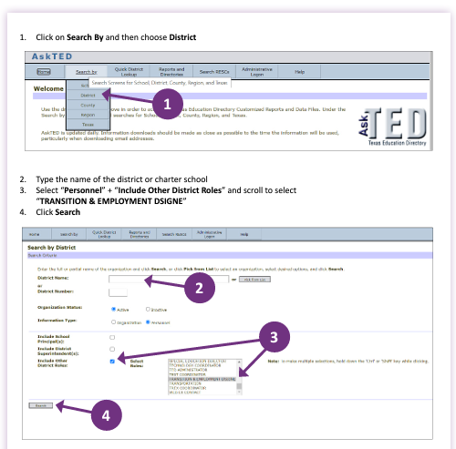
Transition Employment Designee
AskTED

Slide 23
VR Turnover
Due to the many turnovers, and changes in VR Counselors, VR has tried to address the issues associated with this, by providing important information to the Student Navigators who are often involved in school activities, and who sometimes encounter people associated with schools. This information provides the following :
TVRC Name
Name of School
School Contact
E-mail for the school Contact
Telephone number for the School Contact
Schedule the TVRC is on School Campus
By providing this information to the Navigators, this information is often shared with school contacts when necessary. The Navigators are often on school campuses and involved in activities that involve schools. This information also allows the TVRC and the SHN to work together when necessary. As the Regional Transition Supervisor, this information allows me to answer calls and e-mail messages from schools who are searching for a TVRC representative for their campus.

Slide 24
ARD Meetings

Slide 25
ARD Meeting Participation
ARD= Admission, Review, Dismissal
TVRC’s and VRC’s are beholden to participate in ARD meetings when invited within a certain amount of time, specified in the TEA/TWC Memorandum of Understanding. If a student has already been referred to VR, school staff can document the referral has been completed to fulfill the ARD request requirement.
“Participation” can look differently based on needs of school and availability of counselor (phone call, virtual, written statement, in person attendance). It is important to discuss appropriate times to ask for VR participation in ARDs.
School Plans done at the start of the year can be instrumental in planning for counselor participation in this meeting.

Slide 26
Suggestions for before the ARD Meeting
The LEA collects data to determine goals, activities, etc.
Communicate with families about TWS Service (if not a customer)
Share work experience data, evaluations, etc. for transition planning services (if a customer)
Share activities being worked on with a customer that can be supported by the LEA
What important information about the child’s strengths, interests and needs can a family provide?

Slide 27
Suggestions for during the ARD Meeting
The LEA develops the IEP for the next annual ARD year.
Accommodations for employment that could be beneficial to the student in work experiences or CTE.
Suggest potential courses to support the student.
What are employers looking for in a workplace, related to the student’s postsecondary goals?
If a customer, what is the IPE plan for long term education & employment for the student?
How can the family be a part of the services provided by the LEA and TWS?

Slide 28
Suggestions for after the ARD Meeting
The LEA will progress monitor, implement the goals & activities developed.
Provide ongoing communication and follow-up.
VR should plan to be on the campus once a week to meet with staff, students, and families.
Meet with the Transition Employment Designee or Transition Specialist for the district once a month.
Communicate and include the family in discussion of services provided.
Communicate with the school and families when issues arise.

Slide 29
Serving Younger Students

Slide 30
Expectations Matter
https://spedsupport.tea.texas.gov/resource-library/autism-expert-interviews/expectations-matter

Slide 31
Legislative update
Aligns both federal and state transition requirements to no later than the first IEP to be in effect when the student turns 14 TAC §89.1055 (k-m)
Back to school updates for special educators from TEA
Volume 1
Volume 2

Slide 32
Exploring Postsecondary Education and Employment
Ideas of services for education
Participate in Self-Advocacy training (VAT)
Understanding your Accommodations and asking for them
Group Skills Training, including Pre-ETS focused summer camps
Ideas for exploring employment
Job Shadowing
Interviews for potential jobs
Career Exploration (VAT)
Workplace Readiness (VAT)

Slide 33
What is Self-Determination?
"There are multiple definitions of self-determination, but generally, it describes individuals who:
act or cause things to happen as they set and work toward goals in their lives (Shogren, 2020) and who
make choices,
solve problems,
set goals,
evaluate options,
take initiative to reach one’s goals, and
accept consequences of one’s actions (Rowe et al., 2015).
It is a research-based predictor of positive outcomes for individuals with disabilities (Mazzotti et al., 2021)."
Source: NTACT:C. (nd) Self-Determination. https://transitionta.org/topics/secondary-education/self-determination/

Slide 34
Self-Determination
Resources
Next Steps to Independence
I'm Determined
NTACT:C

Slide 35
Assessment
Texas Workforce
Labor Market Information Program
Vocational Evaluation
Resources
Transition Tennessee Transition Assessment Database
Indiana Secondary Transition Resource Center

Slide 36
Other Considerations
Possibly utilize Potentially Eligible for 14 & 15 year old students?
Family Participation
What does that look like?
What tools and resources are you sharing with them?
Next Steps to Independence
Roadmap to Texas Transition Resources

Slide 37
Let’s Discuss Pre-Employment Transition Services

Slide 38
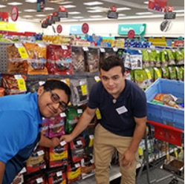
Pre-Employment Transition Services
WIOA (July 2014) utilizes the term:
“Pre-Employment Transition Services” as the type of services that are most impactful for students with disabilities.
These services help students prepare for employment opportunities. They serve as key building blocks and are at the core of TWC-VR Transition Services.
Career exploration
Self-advocacy
Workplace readiness training
Work-based learning experiences
Counseling on post-secondary options

Slide 39
Initiating In-School VR Services

Slide 40
When a school wants to establish in-school VR Services:
Submit an email to VR.Pre-ETS@twc.texas.gov or Rosla.Hocker@twc.texas.gov with the following information:
Contact person and their info, including which school/district.
What services are you hoping to establish? (e.g. Embedded Pre-ETS, standard Pre-ETS, VAT)
Do you have a provider in mind? If yes, who?
Have you spoken to any local VR staff about services? If yes, who?
Do you have regular contact with your assigned VR counselor?
Someone from the State Office Transition Team will connect you with the appropriate regional staff to start the conversation (in TWC Region 2/ESC Regions 10 & 11 this is Rosla Hocker), including the Regional Director, Deputy Regional Director, Unit Manager/Supervisor, and the VR Counselor.

Slide 41
Please do not:
Discuss services with anyone other than VR until services have been agreed on.
If a provider approaches you, please tell them you need to reach out to us and you’ll get back to them.
Create MOUs or other agreements that involve VR services or funds without talking with VR first.
Assume VR funding will be provided without approval from VR.
Initiating In-School VR Services Document

Slide 42
Keep in mind:
TWC services are intended to enhance what you already provide to students, not replace them.
VR providers go through a process that results in a contract and includes established qualifications to provide that service. They are not necessarily certified teachers.
Referrals are always initiated by the counselor. They should be your first contact if you want to refer students for any VR service, in school or out.

Slide 43
Student Referral

Slide 44
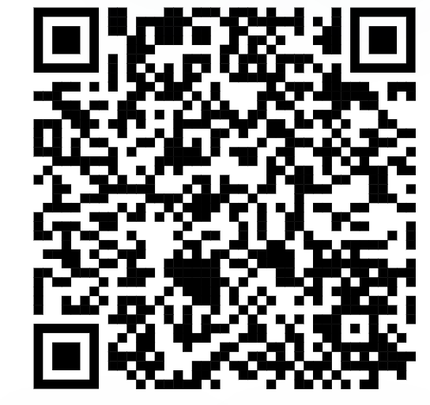
Initiating Contact with Your VR Office
Contact your assigned TVRC or VRC High School Liaison
Call VR Inquiries at (512) 936-6400
Use VR Office Locator website (find an office near you)
Email vr.office.locator@twc.texas.gov with your name, phone number, and address
Engage with your local Regional Transition Program Specialist to find appropriate counselor

Slide 45
Submitting an Online Self-Referral
If there is no other way for a student or the referring party to connect with VR staff, there is the option for an online self- referral.
Before taking advantage of this option, it should be noted that the customer’s information is being put into the system and then transferred until it is with the correct staff person to handle the case.
This process may take much longer than a traditional referral, due to the referral coming through a different channel of communication.

Slide 46
Submitting an Online Self-Referral (Continued)
Start My VR – Online Self-Referral

Slide 47
Supplementing vs Supplanting
VR should not cover items included on the student’s IEP because this is the school’s responsibility under IDEA.
All services VR provides must be reasonable and necessary for the student to reach employment goal.
When gray areas in services arise, it is best to meet and discuss the need so that the two agencies can partner and pool resources.
Example of gray area: Work Experience supported by both the school and Vocational Rehabilitation.

Slide 48
Student Referral Process
School staff have the option to submit a VR 2002 Referral Form for each student referral; signatures are not required for this form.
In addition, school staff also have the option to submit school records and reports upon signed release from student/guardian.
School staff and VR Counselor set up a meeting to discuss student referrals, pertinent information is obtained to start the understanding of student's needs.
Appropriate Referrals:
SPED Students
504 Students
18+ Students
Career and Technical Education (CTE) Students
Students who have not disclosed their disability, but Teachers/Nurses see needs on campus.
NOTE: The VR 1820 form is not completed by school staff.

Slide 49
Student Referral Process (continued)
Counselor should contact student and parent to determine appropriate services where information is obtained to further understand the student’s needs and for the cousnelor to explain the purpose of the VR program.
Depending on the type of appropriate services, VR Counselors will follow the Potentially Eligible Process or the VR Application Process, by placing the student in Initial Contact with Case Assignment on the corresponding caseload.
If the student will go through the Potentially Eligible Process, a VR 1820 can be submitted. Only one VR 1820 form is necessary for the life of the case.
If the student will go through the VR Application Process, an application appointment is scheduled within 30 days.

Slide 50
Two Pathways to Vocational Rehabilitation Services
VR Eligible Pathway
Potentially Eligible Pathway
Note: Pre-ETS are provided to individuals who meet the definition of a student with a disability and are eligible or potentially eligible for VR services.
VRSM Policy Reference
C-1305-10: Working with Potentially Eligible Students

Slide 51
Potentially Eligible

Slide 52
Who is considered Potentially Eligible?
Working with Potentially Eligible Students
To receive Pre-ETS and be considered potentially eligible for VR services, an individual must meet only the definition of a student with a disability.
The scope of services are limited to Pre-ETS.
Potentially eligible students are not subject to Basic Living Requirements or other cost sharing requirements.
VRSM Policy Reference
C-1305-10: Working with Potentially Eligible Students

Slide 53
VRSM Part C – Chapter 8.1 Pre-ETS : Student with a Disability
Based on federal regulations (34 CFR §361.5(c) (51)), in Texas, a student with a disability is defined as an individual between the ages of 14 and 22 who is:
enrolled in a recognized educational program, which may include public schools (including charter schools), private schools, home schools, recognized post-secondary programs, or other recognized settings, such as the schooling provided by juvenile justice facilities;
receiving services through the Individuals with Disabilities Education Act (IDEA) (Special Education); or
considered eligible for Section 504 services.

Slide 54
Pathway to Potentially VR Eligible
Use Potentially Eligible for a Younger Student When:
The Student will only need Pre-ETS at this time;
The Student has not expressed interest in applying for VR services;
The Student would like to participate in a Pre-ETS activity in the immediate future; or
The Student is at the beginning of their career exploration with limited experience or knowledge of career interests and would benefit from Pre-ETS at this time.

Slide 55
Pathway to VR Eligible
Take an Application for a Younger Student When:
The Student has a need for additional support services which cannot be provided under potentially eligible, such as, work experience training, transportation, and will need Pre-ETS support services (see next slide);
The Student has expressed interest in applying for VR services and does not plan to participate in Pre-ETS immediately; or
The Student has identified their Career Pathway of Interest and will benefit from VR services on an IPE.

Slide 56
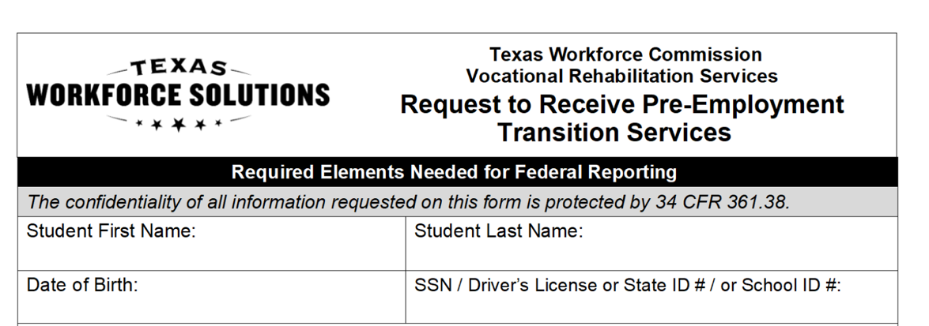
Potentially Eligible Process
Counselor drives the process and completes VR1820 Request for Pre-ETS form for each student requiring only Pre-Employment Transition Services. Social security number is preferred but other unique identifiers such as State ID or School ID number can be used. Parent or Guardian must sign 1820 form if student is underage.
Counselors and school staff can work together to get the 1820 forms signed by the student/parent and returned to VR Counselor.

Slide 57
Potentially Eligible Cases: Required Documentation To Verify Disability
Supporting documentation that is required to verify the student's disability may include the following:
Case notes documenting VR counselor observations, review of school records (e.g. IEP or 504 plan), and medical records;
A signed statement from a school professional with the identification of a student's disability and school enrollment status;
Social Security statement / letter verifying disability.
Note for VR Staff: Refer to the new Desk Aide: How to Document a Potentially Eligible Case for guidance regarding how to document a Potentially Eligible case in Rehab Works.

Slide 58
Continuing the Potentially Eligible Process
Applicable releases are required to share information with school, and parental/guardian consent is required if student is a minor.
VR5061 Notice and Consent for Disclosure of Personal Information (required)
VR1517-2 Authorization for Release of Confidential Customer Records and Information for Parents (if the student is not a minor)
VR1517-2 Authorization for Release of Confidential Customer Records and Information for School (recommended by VR Policy to share information with school)
VR5060 Permission to Collect Information (required if school records are requested)
For Work-Based Learning, VR staff asks the customer to provide original unexpired documents that prove his or her identity and show that the customer can work legally in the United States. Examples of work-based learning placement include:
SEAL
Placements through Paid or Unpaid Work Experience

Slide 59
VR Process Timeline

Slide 60
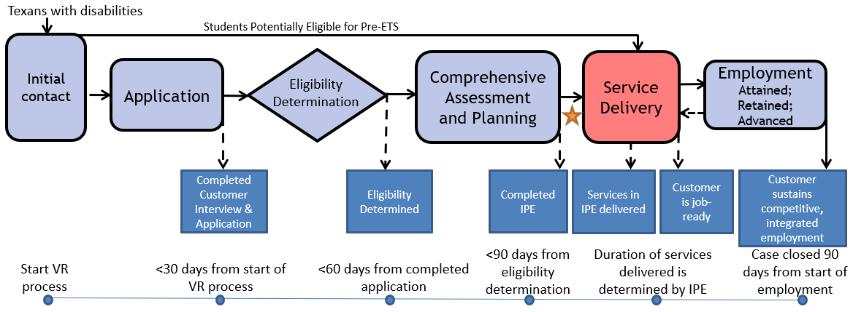
The VR Process and Timelines
30 → 60 → 90-day timelines

Slide 61
Collaborating for Student Success: Texas Workforce and Schools
Next Meeting
October 15, 2024
1:00-2:00 via Zoom
Region 10 Registration
Region 11 Registration
Texas Workforce can register through either entity or watch for a Zoom link from Rosla

Slide 62
Use Texas SPED Support to find your Educational Service Center Contacts

Slide 63
State Office Transition Team
Erin Wilder Program Manager 512-936-3707 Erin.Wilder@twc.texas.gov | Kevin Markel Program Specialist 817-727-9045 Kevin.Markel@twc.texas.gov | Alyssa Kee Program Specialist 915-217-8188 Alyssa.Kee@twc.texas.gov | Kristen Davis Program Specialist 512-221-9071 Kristen.Davis@twc.texas.gov
Laura Villarreal Neurodevelopmental Specialist 512-541-6439 Laura.Villarreal@twc.texas.gov | Leigh Ann Godinez Program Specialist 512-720-8347 Leighann.Godinez@twc.texas.gov | Gabriela Martinez Program Specialist 956-566-1228 Gabriela.Martinez@twc.texas.gov | Team Mailbox VR.Pre-ETS@twc.texas.gov

Slide 64
Questions

Slide 65
Texas Workforce Solutions-Vocational Rehabilitation Services
101 East 15th Street
Austin, Texas 78778-0001
512-936-6400
VR.office.locator@twc.state.tx.us
Equal Opportunity Employer/Program
Auxiliary aids and services are available upon request to individuals with disabilities.
The Texas Workforce Commission accepts calls made
through any relay service provider.
www.twc.texas.gov

Slide 66
Federal Funding
These activities are financed under the TWC Federal Vocational Rehabilitation grant. For the Federal fiscal year 2024 (October 1, 2023, through September 30, 2024), TWC anticipates expending $320,291,817 in Federal Vocational Rehabilitation funds. Funds appropriated by the State pay a minimum of 21.3% of the total costs ($86,686,349) under the Vocational Rehabilitation program. Revised June 2024.
For purposes of the Supported Employment program, the Vocational Rehabilitation agency receives 94.7 percent of its funding through a grant from the U.S. Department of Education. For the 2024 Federal fiscal year, the total amount of grant funds awarded are $1,501,230. The remaining 5.3 percent ($83,402) are funded by Texas State Appropriations. Revised June 2024.
For purposes of the Independent Living Services for Older Individuals who are Blind program, the Vocational Rehabilitation agency receives 90 percent of its funding through a grant from the U.S. Department of Education. For the 2024 Federal fiscal year, the total amount of grant funds awarded are $2,213,488. The remaining 10 percent ($245,943) are funded by Texas State Appropriations. Revised June 2024.

