Slide 1
Pre-ETS Regional Training Breakouts VR Region 3 ESC 12 Part of ESC 6 and ESC 13
Statewide Capacity Building Conference
Frisco, TX
October 2024

Slide 2
Presenters
Judy Siebel
VR Region 3
Transition Specialist
Leigh Ann Godinez, CRC, LPC
VR State Office
Transition Program Specialist
Monica Johnson
ESC 12 Education Specialist

Slide 3
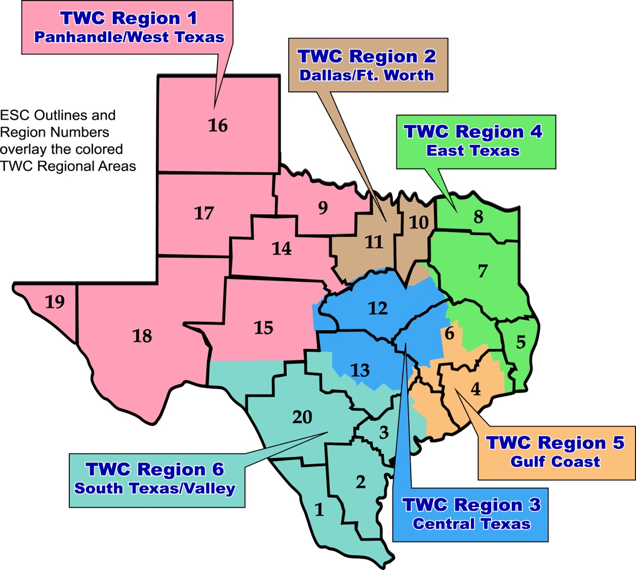
Map of Texas with VR and ESC Regions

Slide 4
Myths vs. Facts
Myth 1: If the student has not been referred to VR by a certain time frame, we cannot engage the student.
Myth 2: VR only serves Junior & Seniors in high school.
Myth 3: You will receive any of the available services you want.
Myth 4: Just like in high school, you are entitled to VR Services. Because you received SpeEd or 504 you automatically receive VR Services.
Myth 5: Social Security recipients lose their benefits when they apply for VR services.
Myth 6: A VR Counselor must attend all ARD meetings.
Myth 7: I/Parents make too much money to apply for VR.
Fact 1: VR cannot deny an interest to apply for services at any point.
Fact 2: VR can serve a student with a disability as early as 14 years of age.
Fact 3: Your VR Counselor will consider your individual situation and need for appropriate services.
Fact 4: An individual must be determined eligible into the VR Program. Entitlement vs. Eligibility
Fact 5: VR encourages SS recipients to apply. SMURF, CWIC Referral.
Fact 6: No. The MOU section 6.1.9 and 6.4.5. appropriate; more detail forthcoming.
Fact 7: No. Pre-ETS services are not subjected to this. All other customers, refer VRSM Policy

Slide 5
Goals for Today
Understanding the transition process as a tool to help prepare students and families for a successful post secondary success including making a connection to outside agencies.

Slide 6
Stephen Covey Quote
“To Begin with the end in mind means to start with a clear understanding of your destination. It means to know where you’re going so that you better understand where you are now so that the steps you take are always in the right direction.”
-Stephen Covey-The Seven Habits of Highly Effective People.
6

Slide 7
Capacity Building for a Stronger Collaboration
Collaboration and Communication for student success
How systems benefit from seamless transition collaboration
What are Pre-Employment Transition Services (Pre-ETS)
How ISD Staff can initiate contact with VR Staff
Starting the student referral process
Two Pathways to Vocational Rehabilitation Services:
(1) Potentially VR Eligible and (2) VR Eligible
When to enter into each VR Phase?
Review of the Potentially Eligible Process

Slide 8
Importance of Collaboration
Collaboration is a predictor of positive postschool outcomes for students with disabilities when it occurs across education, vocational rehabilitation, families, and numerous other partners who provide instruction, pre-employment transition services, and other transition services stakeholders.
Well-developed partnerships for planning and service delivery give the greatest benefit to youth and their families.
Source: Interagency Collaboration - NTACT:C (transitionta.org)

Slide 9
Seamless Transition Collaboration How Systems Benefit
Education
More meaningful Individual Education Plans (IEP) and transition plans required under the Individuals with Disabilities Education Act (IDEA);
Additional positive outcomes required by IDEA Indicator 14 reports, and post-school follow up shows more former students working.
More meaningful 504 Plans required under the 504 Rehabilitation Act.
Vocational Rehabilitation
Clear opportunities to meet WIOA requirements to collaborate with education agencies;
More successful case closures, that is, services to youth with I/DD and other significant disabilities result in successful employment.
State I/DD and Other Service Agencies
More efficient application of resources when providing services to youth who exit school already working.

Slide 10
Key Areas for Improved Collaboration
Early Identification and Referral:
Challenge: Lack of timely identification of students who could benefit from VR services.
Solution: Streamline referral processes between school districts and TWC to ensure earlier interventions.
Shared Data and Resources:
Challenge: Limited sharing of relevant student data between TWC and school districts.
Solution: Establish clear protocols for data sharing to better tailor services to individual student needs, in compliance with FERPA.
Joint Professional Development:
Challenge: Educators and VR counselors often work in silos.
Solution: Offer joint training opportunities on transition planning, special education, and VR services.

Slide 11
Collaboration Through Transition Planning
Individualized Education Program (IEP) & Individualized Plan for Employment (IPE):
Encourage VR counselors to attend IEP meetings to coordinate IPE development.
Align IEP and IPE goals to create a seamless transition from school to work.
Work-Based Learning Integration:
Increase opportunities for students to participate in work-based learning as part of their IEP goals.
Collaborate with employers to provide real-world training and internships.

Slide 12
Collaboration Issues
ISD’s unable to able to identify the assigned VR counselor
Limited capacity on VR caseloads and certain programs
Deadlines for programs not being communicated
VR applications delayed or not taken
Program capacities and slots not uniformly allotted (ex. SEAL)
Planning/coordination of programs hindered due to apprehension of supplanting services

Slide 13
MOU
Duration of the Agreement
September 1, 2022, through August 31, 2027

Slide 14
Section 1 - Purpose of the TWC-TEA MOU An agreement to provide VR Transition Services to students with disabilities to assist them to enter CIE)
The agreement seeks to:
Increase coordination to identify and prepare students with disabilities to move to post-secondary education and or CIE
Improve transition planning to facilitate the development and implementation for the IEP
Establish and periodically update a mechanism to identify the areas of the state with the greatest needs for VR transition services
Institute a mechanism to ensure VR staff can attend ARD committee meetings when invited and as appropriate
Provide information about roles and responsibilities include financial responsibilities
Strengthen relationships to facilitate successful outcomes for students with disabilities.

Slide 15
Section 2 – Definitions in the Agreement
Vocational Rehabilitation
Graduation
TWC
LEA
WIOA
IPE
IDEA
IEP
CIE
WITW
VR Pre-ETS
Student with a Disability
TEA
ESC
Potentially Eligible
VR Transition Services
ARD

Slide 16
Group Activity: MOU Review
Pull copy of the MOU between TWC-TEA in your conference packet
We want to ensure we have at eat table, a mixed group of TWC-VR staff as well as our School Partners
Decide what questions you have and highlight 1-2 of them
Identify a person from within your group who will share out your questions
Any pending questions: Place in the “Parking Lot”

Slide 17
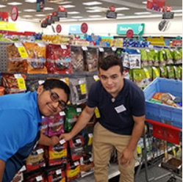
Pre-Employment Transition Services
WIOA (July 2014) utilizes the term:
“Pre-Employment Transition Services” as the type of services that are most impactful for students with disabilities.
These services help customers prepare for employment opportunities. They come before actual employment and cease at that time.
Career exploration
Self-advocacy
Workplace readiness training
Work-based learning experiences
Counseling on post-secondary options

Slide 18
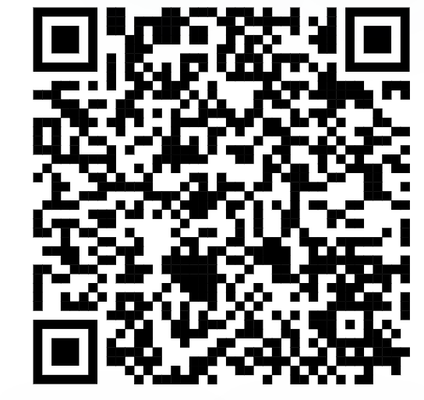
Initiating Contact with Your VR Office
Contact your assigned TVRC or VRC High School Liaison
Call VR Inquiries at (512) 936-6400
Use VR Office Locator website (find an office near you)
Email vr.office.locator@twc.texas.gov with your name, phone number, and address
Engage with your local Regional Transition Program Specialist to find appropriate counselor

Slide 19
Submitting an Online Self-Referral
If there is no other way for a student or the referring party to connect with VR staff, there is the option for an online self- referral.
Before taking advantage of this option, it should be noted that the customer’s information is being put into the system and then transferred until it is with the correct staff person to handle the case.
This process may take much longer than a traditional referral, due to the referral coming through a different channel of communication.

Slide 20
Submitting an Online Self-Referral (Continued)
Start My VR – Online Self-Referral

Slide 21
Supplementing vs Supplanting
VR should not cover items included on the student’s IEP because this is the school’s responsibility under IDEA.
All services VR provides must be reasonable and necessary for the student to reach employment goal.
When gray areas in services arise, it is best to meet and discuss the need so that the two agencies can partner and pool resources.
Example of gray area: Work Experience supported by both the school and Vocational Rehabilitation.

Slide 22
Student Referral Process
School staff have the option to submit a VR 2002 Referral Form for each student referral; signatures are not required for this form.
In addition, school staff also have the option to submit school records and reports upon signed release from student/guardian.
School staff and VR Counselor set up a meeting to discuss student referrals, pertinent information is obtained to start the understanding of student's needs.
Appropriate Referrals:
SPED Students
504 Students
18+ Students
Career and Technical Education (CTE) Students
Students who have not disclosed their disability, but Teachers/Nurses see needs on campus.
NOTE: The VR 1820 form is not completed by school staff.

Slide 23
Student Referral Process (continued)
Counselor should contact student and parent to determine appropriate services where information is obtained to further understand the student’s needs and for the counselor to explain the purpose of the VR program.
Depending on the type of appropriate services, VR Counselors will follow the Potentially Eligible Process or the VR Application Process, by placing the student in Initial Contact with Case Assignment on the corresponding caseload.
If the student will go through the Potentially Eligible Process, a VR 1820 can be submitted. Only one VR 1820 form is necessary for the life of the case.
If the student will go through the VR Application Process, an application appointment is scheduled within 30 days.

Slide 24
Suggestions for before the ARD Meeting
The LEA collects data to determine goals, activities, etc.
Communicate with families about TWS Service (if not a customer)
Share work experience data, evaluations, etc. for transition planning services (if a customer)
Share activities being worked on with a customer that can be supported by the LEA
What important information about the child’s strengths, interests and needs can a family provide?

Slide 25
Suggestions for during the ARD Meeting
The LEA develops the IEP for the next annual ARD year.
Accommodations for employment that could be beneficial to the student in work experiences or CTE.
Suggest potential courses to support the student.
What are employers looking for in a workplace, related to the student’s postsecondary goals?
If a customer, what is the IPE plan for long term education & employment for the student?
How can the family be a part of the services provided by the LEA and TWS?

Slide 26
Suggestions for after the ARD Meeting
The LEA will progress monitor, implement the goals & activities developed.
Provide ongoing communication and follow-up.
VR should plan to be on the campus once a week to meet with staff, students, and families.
Meet with the Transition Employment Designee or Transition Specialist for the district once a month.
Communicate and include the family in discussion of services provided.
Communicate with the school and families when issues arise.

Slide 27
Goals of the MOU between TWC & TEA
Improved Transition Services:
Support students with disabilities transitioning from high school to postsecondary education or employment.
Increased Access to Vocational Rehabilitation Services:
Ensure students with disabilities can access VR services during high school to prepare for the workforce.
Collaborative Planning and Communication:
Strengthen collaboration between school districts, VR counselors, and other stakeholders.

Slide 28
Roles and Responsibilities Under the MOU
School Districts:
Identify students with disabilities who may benefit from VR services.
Collaborate with VR counselors to integrate VR services into students’ IEPs.
ESC:
Provide guidance to school districts on the implementation of the MOU.
Help make the connection with TEA to monitor district compliance with the collaboration provisions outlined in the MOU.

Slide 29
School Plans
The School Plan is a great tool for establishing procedures and accountability with schools. This can be a valuable tool in establishing and maintaining effective partnerships with schools.
Key components for the School Plan include:
Relevant points of contact for TWC and the ISD
Joint goals for the school year
Overview of the referral and communication processes, including follow up
Opportunities for collaboration
Parents night, career fair, group orientations, etc.
Processes for data tracking and storage

Slide 30
VR School Plan Guidelines

Slide 31
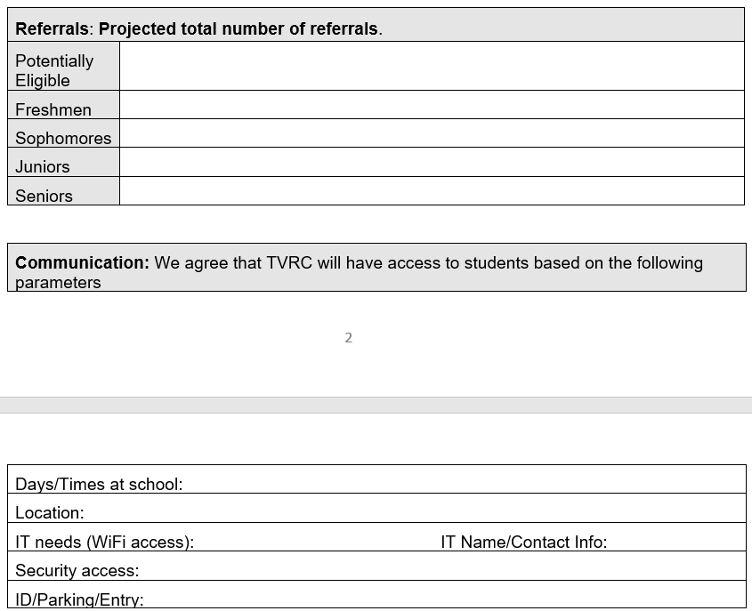
School Plan Slide

Slide 32
School Plan Slide 2

Slide 33
What is a TED?
The TED is an employee in a district or charter school who is designated as the primary contact for transition and employment services for students with disabilities in special education programs.
This employee must be able to provide information and resources about effective transition planning and employment services to school staff, students, parents, and agency providers. Local education agencies, or LEAs, can change this designation, as needed, to make sure that the employee serving in this role has the appropriate knowledge and skills necessary for providing information about effective transition services.
You can find TED for any district in Texas on TEAs website under AskTED
Notes:
Who to contact at the school??
The transition and employment services designee,or TED,is the district or charter school contact for transition and employment services for students enrolled in special education programs. What is the role of a TED? The TED must provide information and resources about transition planning and services.They must also ensure communication and collaboration between students, parents, and staff of the Health and Human Services Commission,the Texas Workforce Commission, the Department of State Health Services, and the Department of Family and Protective Services.

Slide 34
Texas Administrative Code (TAC)
TAC Amendment | Next Steps
Aligns both federal and state transition requirements to no later than the first IEP to be in effect when the student turns 14 TAC §89.1055 (k-m) Back to school updates for special educators from TEA. | Generate a list of students who turned 14 over the summer or will turn 14 at the start of the school year. For districts that follow a local procedure to wait until age 16 for transition requirements, include students turning 14 up to age 16. Also, consider students in lower grades who might have been retained.
Notes:
This was effective August 1st transition has to be IN PLACE prior to the student turning 14.
Administrative code change that requires all elements of transition planning to start before the student turns age 14. So that everything begins by age 14. This is an area of high non-compliance. I think this is a good think, you can’t transition plan unless you transition plan. How do you do the transition without writing goals until the student turns 16. High non-compliance in Texas as LEAs are doing this after students turn 14.
If you have a 5th grader who is 13, you need to put a transition plan in place for that student. Run reports for elementary and not just middle school. Are we planning for a 6th grader like we would for a 9th grade student. So, yes even a 6th grader planning courses for their high school plan.
SPPI-13 is only age 16 and above on federal.

Slide 35
Target Students: Ages 14-16
Call the campuses and let them know that you can set up meetings with target students (barriers to employment) and their parents. Provide a consent form for the parents to sign to begin this discussion.
Have a list of your campus contacts so someone new can pick it up and get started right away.
Provide resources to the schools for career exploration and work readiness training websites. Get teacher feedback on how they use the resources.
Provide Pre-ETS vocational rehabilitation information to be shared at junior high IEP meetings.
Notes:
How can we get in touch with the younger students? Here are some ideas.

Slide 36
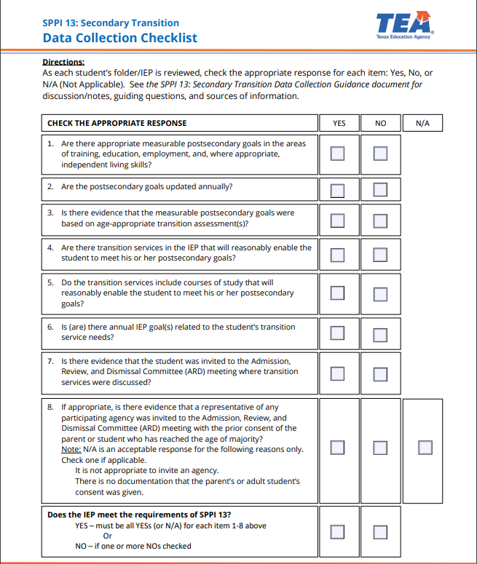
SPPI 13: Secondary Transition Data Collection Checklist
https://tea.texas.gov/sites/default/files/spp13-data-checklist.pdf
Notes:
Question 8 specifically related to your role as a VRC.
The Office of Special Education Programs (OSEP) under the United States Department of Education is tasked with ensuring compliance with the IDEA. OSEP requires states to develop State Performance Plans (SPPs) and Annual Performance Reports (APRs). The SPPs/APRs must include goals and data for indicators specified by OSEP. There are other SPPIs that address preparing students with disabilities for life, work, and postsecondary education. One of the Indicators, SPP Indicator 13, examines the Percentage of youth aged 16 and above with an IEP that includes coordinated, measurable, annual goals and transition services that will reasonably enable the students to meet postsecondary goals.
This background is a picture of the data collection checklist created by the TEA
Are there appropriate measurable postsecondary goals in the areas of training, education, employment, and where appropriate, independent living skills?
Are the appropriate measurable postsecondary goals updated annually?
Is there evidence that the appropriate measurable postsecondary goals were based on age-appropriate transition assessments?
Are there transition services in the individualized education program (IEP) that will reasonably enable the student to meet his or her postsecondary goals?
Do the transition services include courses of study that will reasonably enable the student to meet his or her postsecondary goals?
Is (are) there annual IEP goal(s) related to the student’s transition service needs?
Is there evidence that the student was invited to the Admission, Review, and Dismissal Committee (ARD) meeting where transition services were discussed?
If appropriate, is there evidence that a representative of any participating agency was invited to the Admission, Review, and Dismissal Committee (ARD) meeting with the prior consent of the parent or student who has reached the age of majority?

Slide 37
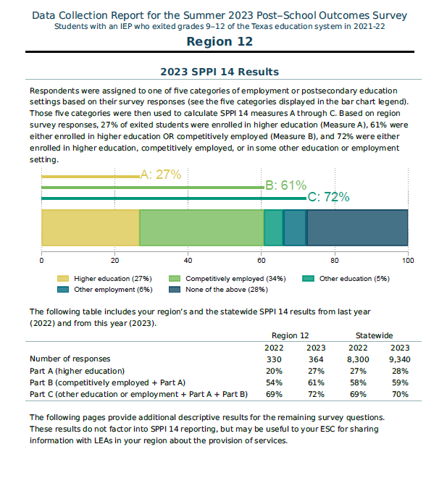
SPPI-14 Reports
Post-School Outcomes Survey Portal
Notes:
Let’s talk Indicator 14, a vital component of the U.S. Department of Education's monitoring requirements for programs serving students with disabilities. This indicator focuses on the Post School Outcomes of students who received special education services while in high school. The Summer 2024 survey opened June 3rd and closes at the end of September
The goal of Indicator 14 is to assess the success of these students one year after they exit high school. It measures three key outcomes:
1. **Part A**: We look at the percentage of students who are enrolled in higher education.
2. **Part B**: We then examine the percentage of students who are either competitively employed or enrolled in higher education, building on the findings from Part A.
3. **Part C**: Finally, we assess the percentage of students who are otherwise employed or enrolled in different types of post-secondary education, including those who are competitively employed or in higher education.
In Texas, to gather this data, the state conducts surveys with students and their families each summer, ensuring we wait one year post-exit for accurate reporting. This process allows us to track and improve the post-school outcomes for our students with disabilities, ensuring they have the support they need to succeed after high school."
Some of your directors may have shared these reports with you from your ISD or your charter school. I hope that they shared it with you, and if not you can ask them. Just say hey I heard that Monica shared
Breakdown and review the results of the SPPI-14 report. Include the link in slides to the Gibson consulting portal.
Here’s a summary of the key points from the "Data Collection Report for the Summer 2023 Post–School Outcomes Survey" for Region 12:
### Response Rates
- **Total students invited:** 1,295
- **Total responses:** 364 (Response rate: 28%)
- **Responses in English:** 95%, in Spanish: 5%
- **Number of campuses represented:** 84
### SPPI 14 Results
- **Higher Education Enrollment (Measure A):** 27%
- **Competitively Employed or in Higher Education (Measure B):** 61%
- **Other Education or Employment Settings (Measure C):** 72%
### Comparison to Previous Year (2022)
- Increased enrollment in higher education from 20% to 27%.
- Competitively employed students increased from 54% to 61%.
### Disability Services in Higher Education
- **Contacted Office of Disability Services:** 42% (2023) vs. 40% (2022).
- **Did not know about such an office:** 36% (2023) vs. 42% (2022).
### Accommodations Received
- Various accommodations were reported, with 26% receiving additional time for assignments and 18% receiving test accommodations.

Slide 38
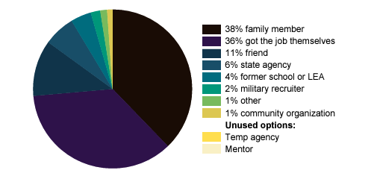
Support Obtaining Job
Notes:
Among the responding exited students in your region who reported having a job at some point during the last year (for any period, for any level of pay, and in any industry), the pie chart shows the proportion who reported help obtaining their job from any of the presented categories.
### Job Support
- Among employed students, 38% received help from family members, while 36% got the job themselves.
-Compared to only 4% received help from their former school of LEA to obtain their job.

Slide 39
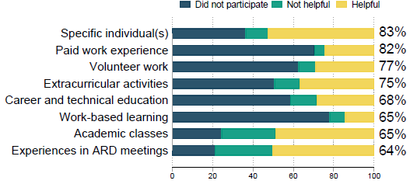
Indicator 14 Results and Predictors of Post School Success
Notes:
The following figures apply to 364 exited students in your region. Helpful Preparation for Employment after High School
77% of responding exiters indicated they had at least one high school experience helpful for employment
after high school. For each experience, such as admission, review, and dismissal (ARD)
meetings, respondents could select that they did not have it, had the experience and found it unhelpful,
or had the experience and found it helpful. The bar chart shows the percentage of students
who selected each option in Region 12, and the percentage on the right side shows the proportion of
students who had each experience and found it helpful
### Helpful High School Experiences
- 77% of respondents indicated they had at least one helpful high school experience related to employment.

Slide 40
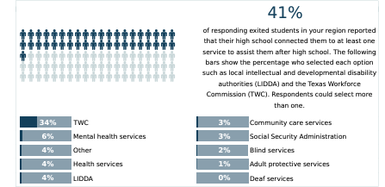
Connection to Services
Notes:
### Connection to Services
- 41% reported their high school connected them to at least one service to assist them after graduation.
For further details, the report includes links to the TEA website for more information on SPPI 14 data collection and reporting.

Slide 41
Two Pathways to Vocational Rehabilitation Services
VR Eligible Pathway
Potentially Eligible Pathway
Note: Pre-ETS are provided to individuals who meet the definition of a student with a disability and are eligible or potentially eligible for VR services.
VRSM Policy Reference
C-1305-10: Working with Potentially Eligible Students

Slide 42
Who is considered Potentially Eligible?
Working with Potentially Eligible Students
To receive Pre-ETS and be considered potentially eligible for VR services, an individual must meet only the definition of a student with a disability.
The only VR requirements that are applied to potentially eligible individuals are informed choice, confidentiality, and access to the client assistance program (34 CFR §361.38, §361.52, and §361.56).
Potentially eligible students are not subject to Basic Living Requirements or other cost sharing requirements.
VRSM Policy Reference
C-1305-10: Working with Potentially Eligible Students

Slide 43
VRSM Part C – Chapter 8.1 Pre-ETS : Student with a Disability
Based on federal regulations (34 CFR §361.5(c) (51)), in Texas, a student with a disability is defined as an individual between the ages of 14 and 22 who is:
enrolled in a recognized educational program, which may include public schools (including charter schools), private schools, home schools, recognized post-secondary programs, or other recognized settings, such as the schooling provided by juvenile justice facilities;
receiving services through the Individuals with Disabilities Education Act (IDEA) (Special Education); or
considered eligible for Section 504 services (includes individuals who are receiving VR services).

Slide 44
Pathway to Potentially VR Eligible
Use Potentially Eligible for a Younger Student When:
The Student will only need Pre-ETS at this time;
The Student has not expressed interest in applying for VR services;
The Student would like to participate in a Pre-ETS activity in the immediate future; or
The Student is at the beginning of their career exploration with limited experience or knowledge of career interests and would benefit from Pre-ETS at this time.

Slide 45
When To Use Potentially Eligible Scenario
Younger Customers seeking Pre-ETS Services only (e.g., 14–16-year-olds requiring minimal supports).
SEAL services without support services (on-site training, transportation, etc.)
Explore STEM Camps
Contracted and Embedded Pre-ETS Services
Explore Apprenticeship Program
Students without work permits (i.e., SS cards)
Student that may already have a RHW a case without assignment (do not duplicate cases).
Student not already entered in RHW (i.e., IC, Application, Eligibility).

Slide 46
Pre-ETS Support Services
Driver’s and Transportation Training - Public Transportation is not always available.
Applied Behavior Analysis (Social Skills Training), Birkman Career Exploration Assessment, and other Autism Supports
Work Experience Training Services

Slide 47
Pathway to VR Eligible
Take an Application for a Younger Student When:
The Student has a need for additional support services which cannot be provided under potentially eligible, such as, work experience training, transportation, and will need Pre-ETS support services (see next slide);
The Student has expressed interest in applying for VR services and does not plan to participate in Pre-ETS immediately; or
The Student has identified their Career Pathway of Interest and will benefit from VR services on an IPE.

Slide 48
Scenarios: VR Eligible Pathways
Student is found eligible for VR services, proceed with VR process (i.e., complete IPE).
Student found ineligible for VR services, will not be able to be placed in Potentially Eligible Phase but can appeal the finding or reapply for full VR services.
Graduating Seniors warranting VR services for post-secondary life.
College Students warranting VR services while in college.
HS student in need of support services.
HS student expressing interest of VR services to address disability.

Slide 49
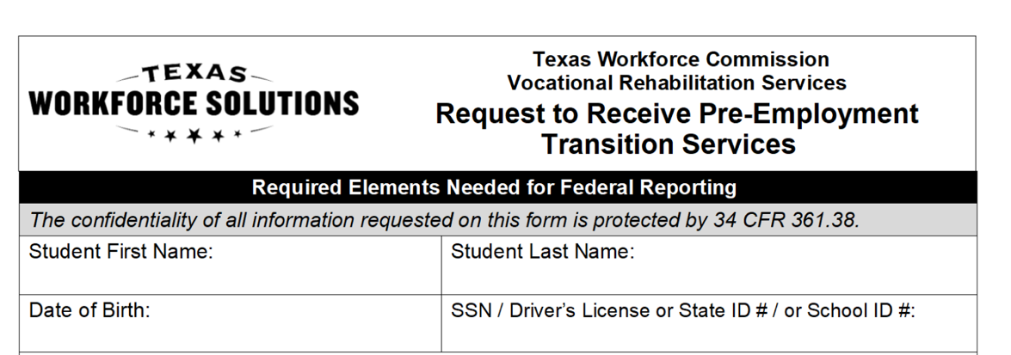
Potentially Eligible Process
Counselor drives the process and completes VR1820 Request for Pre-ETS form for each student requiring only Pre-Employment Transition Services. Social security number is preferred but other unique identifiers such as State ID or School ID number can be used. Parent or Guardian must sign 1820 form if student is underage.
Counselors and school staff can work together to get the 1820 forms signed by the student/parent and returned to VR Counselor.

Slide 50
Potentially Eligible Cases: Required Documentation To Verify Disability (Policy Reference: VRSM Part C – Chapter 8.1 Pre-ETS)
Supporting documentation that is required to verify the student's disability may include the following:
Case notes documenting VR counselor observations, review of school records, and statements of education staff;
A signed statement from a school professional with the identification of a student's disability and school enrollment status (A template of the VR Disability Verification Letter is available on the Transition Intranet Page);

Slide 51
Potentially Eligible Cases: Required Documentation To Verify Disability (Policy Reference: VRSM Part C – Chapter 8.1 Pre-ETS) – Continued
A copy of an IEP, Social Security Administration (SSA) beneficiary award letter, school psychological assessment, documentation of a diagnosis or disability determination, or documentation relating to Section 504 accommodations.
Note for VR Staff: Do not use an Eligibility Case Note to document disability for a Potentially Eligible Case. Refer to the new Desk Aide: How to Document a Potentially Eligible Case for guidance regarding how to document a Potentially Eligible case in Rehab Works.

Slide 52
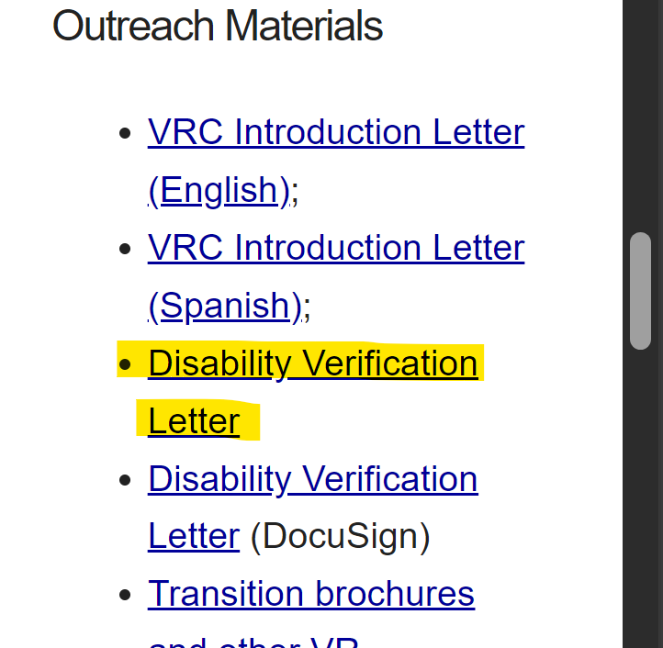
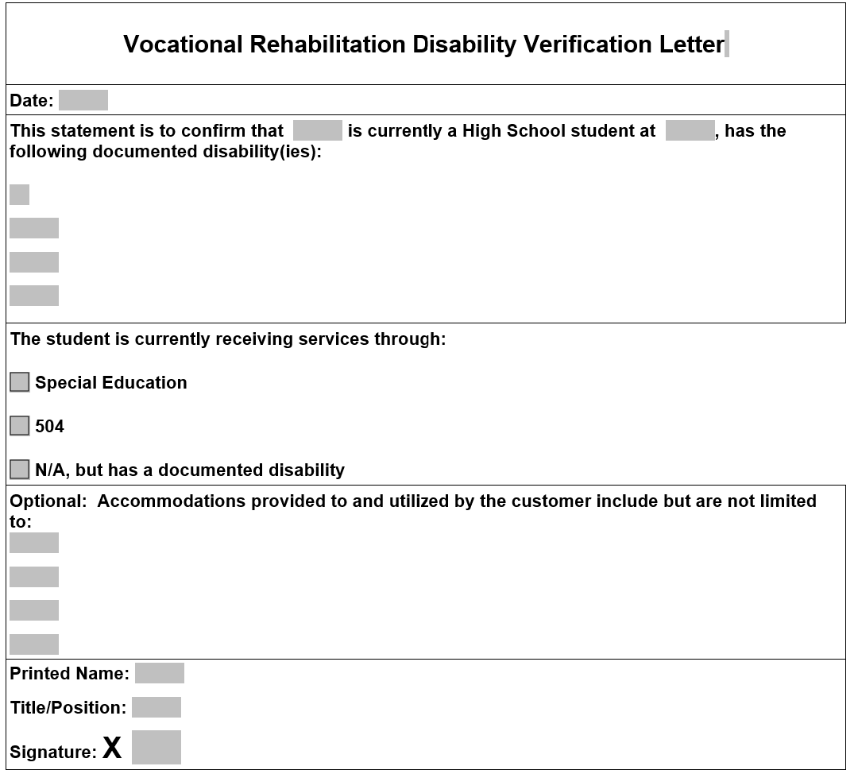
VR Disability Verification Letter on TWS-VRS Transition Intranet Page

Slide 53
Starting The Potentially Eligible Process
Applicable releases are required to share information with school, and parental/guardian consent is required if student is a minor.
VR5061 Notice and Consent for Disclosure of Personal Information (required)
VR1517-2 Authorization for Release of Confidential Customer Records and Information for Parents (if the student is not a minor)
VR1517-2 Authorization for Release of Confidential Customer Records and Information for School (recommended by VR Policy to share information with school)
VR5060 Permission to Collect Information (required if school records are requested)
For Work-Based Learning, VR staff asks the customer to provide original unexpired documents that prove his or her identity and show that the customer can work legally in the United States. Examples of work-based learning placement include:
SEAL
Placements through Paid or Unpaid Work Experience

Slide 54
Potentially Eligible Process (continued)
Counselors provide students with “Can We Talk” Brochure for informed choice and appeal procedures.
Counselor completes any needed Service Justification and Service Authorizations for services provided in PE phase.
Potentially eligible students may immediately engage in pre-employment transition services as well as apply for the full range of VR services.
Counselor documents case notes on customer progress in all Pre-ETS.
Counselor works with student/parents and Pre-ETS vendor to determine the need for additional Pre-ETS versus the need for additional supports and VR application.

Slide 55
Potentially Eligible Cases: Case Notes Policy Reference: VRSM Part C – Chapter 8.1 Pre-ETS
The TVRC or VR counselor assigned to the potentially eligible case must enter case notes in RHW that document information about the student, justification for services, progress, and outcomes. Topics that must be documented in one case or multiple case notes, when applicable, are:
a description of the disability, functional limitations, and counselor observations; we should add corresponding case notes, as it can be confusing.
a record of the disability from the student’s perspective;

Slide 56
Potentially Eligible Cases: Case Notes Policy Reference: VRSM Part C – Chapter 8.1 Pre-ETS(continued)
counseling and guidance and other Pre-ETS provided directly by the VR counselor;
a service justification case note that indicates the planned services, including the type of, and rationale for, Pre-ETS; and
the skills gained, as well as other progress made by the student as a result of receiving Pre-ETS
For More information on Pre-ETS case notes and activities, reference TWC Desk Aide for Potentially Eligible Vocational Rehabilitation Division: Transition Services for Students and Youth with Disabilities (texas.gov) and the new Desk Aide: How to Document a Potentially Eligible Case.

Slide 57
VR Process Timeline

Slide 58
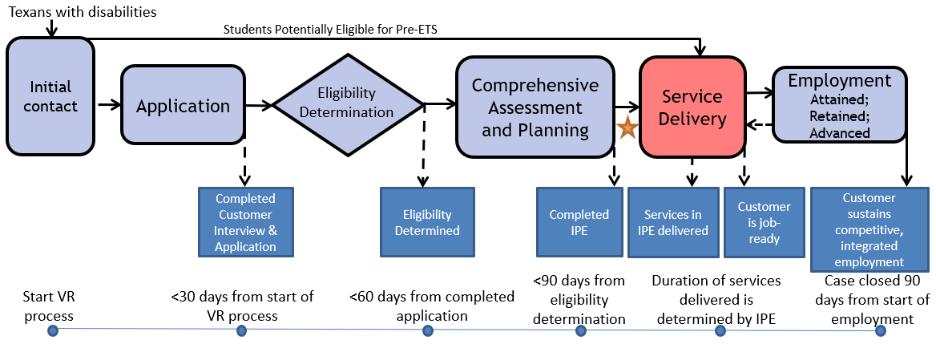
The VR Process and Timelines
30 → 60 → 90-day timelines

Slide 59
Common Forms and When to Use Them
VR5060 Permission to Collect Information | A customer authorizes VR to collect information or records from an individual or entity. A customer completes an application and: An individual at a 14c is interested in applying for VR services, VR is requesting records or information, or VR discloses records to a juvenile service provider. | The release is valid for 365 days from the date signed, or until the date when the VR case is closed, whichever date occurs earlier.
VR5061 Notice and Consent for Disclosure of Personal Information | A customer acknowledges that VR may need to disclose personal information or records to other organizations for purposes directly connected with the administration of their VR services. At application and initial contact without case assignment for potentially eligible. A customer’s file contains alcohol and drug abuse patient records. | No expiration

Slide 60
Common Forms and When to Use Them (Con’t)
VR2002 Referral Form | General Referral Form Does not require signature | No expiration
VR1820 Request to Receive Pre-ETS | Request for Pre-ETS services only Can serve as a referral form. Must be filled out prior to receipt of any Pre-Employment Transition Services. | No expiration; New form is not required each school year.
VR 1487 Designation of Representative | Needed for students that are underage or have a guardian | No expiration; Continues until counselor is notified in writing that it is no longer in effect.

Slide 61
Common Forms and When to Use Them (Continued )
VR1517-2 Authorization for Release of Confidential Customer Records and Information | A customer authorizes VR to release confidential records and information to a person(s) or entity. A customer with no guardian would like for a person that he chooses to be present during appointments with the VR counselor. A transition student would like his counselor to discuss his specific accommodation needs with potential employers. | The release is valid until revoked by the customer or until the date when the customer ceases to be a VR applicant or customer, whichever date occurs earlier.
VR 5063 Permission to Collect and Notice to Disclose - National Student Clearinghouse | The purpose of the VR5063 is to document a customer’s consent to exchange information with National Student Clearinghouse, a source that houses post-secondary student data. The credential information received from National Student Clearinghouse may be used to satisfy reporting and documentation requirements for federal performance measures related to credential attainment. | No expiration

Slide 62
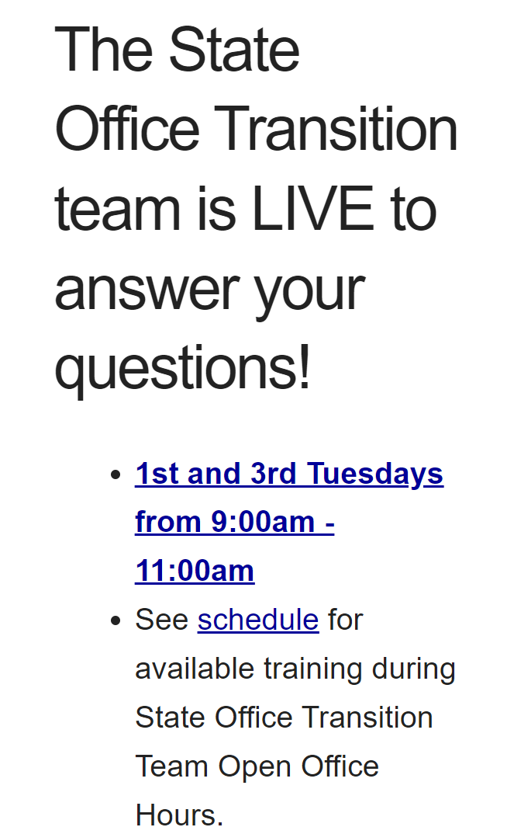
Contact Information and Pre-ETS Office Hours
VR Pre-ETS Mailbox
VR.Pre-ETS@twc.texas.gov

Slide 63
Use AskTED ESC Search Screen (state.tx.us) to find your Educational Service Center Contacts Alternative: Statewide Contacts | Texas SPED Support

Slide 64
Texas Sped Support

Slide 65
State Performance Plan Indicators
SPPI 13 Outcomes
SPPI 13 Looks at transition while the student is in school
All or nothing compliance indicator
8 Questions we have to answer
LEAs must get consent to invite and outside agency
LEAs are required to invite the agencies that will help provide support post-secondary

Slide 66
State Performance Plan Indicators (continued)
SPPI 14 outcomes
SPPI 14: One year post-secondary success
Enrolled in any school, job training, or education program
Contact Office of Disability Services
Supports or accommodations received
Employed full-time or part-time
High school experience most helpful in preparing for employment after high school
High school connect you to any of the following agencies for support while in or out of school

Slide 67
Regional Transition Specialists
Region 1 West Texas Andrew Castillo 915-834-7701 Andrew.Castillo@twc.texas.gov | Region 3 Central Texas Judy Siebel 512-820-1765 Judy.Siebel@twc.texas.gov | Region 5 Houston Janeen Gordon 832-840-2946 Janeen.Gordon@twc.texas.gov
Region 2 Dallas/Ft Worth Rosla Hocker 817-436-4127 Rosla.Hocker@twc.texas.gov | Region 4 East Texas Kirstin Johnson 903-504-9531 Kirstin.Johnson@twc.texas.gov | Region 6 South Texas Rebecca Quintero 210-238-3592 Rebecca.Quintero@twc.texas.gov

Slide 68
State Office Transition Team
Erin Wilder Program Manager 512-936-3707 Erin.Wilder@twc.texas.gov | Kevin Markel Program Specialist 817-727-9045 Kevin.Markel@twc.texas.gov | Alyssa Kee Program Specialist 915-217-8188 Alyssa.Kee@twc.texas.gov | Kristen Davis Program Specialist 512-221-9071 Kristen.Davis@twc.texas.gov
Laura Villarreal Neurodevelopmental Specialist 512-541-6439 Laura.Villarreal@twc.texas.gov | Leigh Ann Godinez Program Specialist 512-720-8347 Leighann.Godinez@twc.texas.gov | Gabriela Martinez Program Specialist 956-566-1228 Gabriela.Martinez@twc.texas.gov | Team Mailbox VR.Pre-ETS@twc.texas.gov

Slide 69
Questions

Slide 70
Texas Workforce Solutions-Vocational Rehabilitation Services
101 East 15th Street
Austin, Texas 78778-0001
512-936-6400
VR.office.locator@twc.state.tx.us
Equal Opportunity Employer/Program
Auxiliary aids and services are available upon request to individuals with disabilities.
The Texas Workforce Commission accepts calls made
through any relay service provider.
www.twc.texas.gov

Slide 71
Federal Funding
These activities are financed under the TWC Federal Vocational Rehabilitation grant. For the Federal fiscal year 2024 (October 1, 2023, through September 30, 2024), TWC anticipates expending $320,291,817 in Federal Vocational Rehabilitation funds. Funds appropriated by the State pay a minimum of 21.3% of the total costs ($86,686,349) under the Vocational Rehabilitation program. Revised June 2024.
For purposes of the Supported Employment program, the Vocational Rehabilitation agency receives 94.7 percent of its funding through a grant from the U.S. Department of Education. For the 2024 Federal fiscal year, the total amount of grant funds awarded are $1,501,230. The remaining 5.3 percent ($83,402) are funded by Texas State Appropriations. Revised June 2024.
For purposes of the Independent Living Services for Older Individuals who are Blind program, the Vocational Rehabilitation agency receives 90 percent of its funding through a grant from the U.S. Department of Education. For the 2024 Federal fiscal year, the total amount of grant funds awarded are $2,213,488. The remaining 10 percent ($245,943) are funded by Texas State Appropriations. Revised June 2024.

