Slide 1
Pre-ETS Regional Training Breakouts
Statewide Capacity Building Conference
Frisco, TX
October 2024

Slide 2
Your Presenters
Kristen Davis, M.S., LPC
VR State Office
Transition Program Specialist
Rebecca Quintero, M.S.
VR Region 6
Senior Transition Specialist
Sam Gonzalez
Education Service Center Region 20
Education Consultant for Transition

Slide 3
Myths vs. Facts
Myth 1: If the student has not been referred to VR by a certain time frame, we cannot engage the student.
Myth 2: VR only serves Junior & Seniors in high school.
Myth 3: You will receive any of the available services you want.
Myth 4: Just like in high school, you are entitled to VR Services. Because you received SpeEd or 504 you automatically receive VR Services.
Myth 5: Social Security recipients lose their benefits when they apply for VR services.
Myth 6: A VR Counselor must attend all ARD meetings.
Myth 7: I/Parents make too much money to apply for VR.
Fact 1: VR cannot deny an interest to apply for services at any point.
Fact 2: VR can serve a student with a disability as early as 14 years of age.
Fact 3: Your VR Counselor will consider your individual situation and need for appropriate services.
Fact 4: An individual must be determined eligible into the VR Program. Entitlement vs. Eligibility
Fact 5: VR encourages SS recipients to apply. SMURF, CWIC Referral.
Fact 6: No. The MOU section 6.1.9 and 6.4.5. appropriate; more detail forthcoming.
Fact 7: No. Pre-ETS services are not subjected to this. All other customers, refer VRSM Policy

Slide 4
Goals for Today
Understanding the transition process as a tool to help prepare students and families for a successful post secondary success including making a connection to outside agencies.

Slide 5
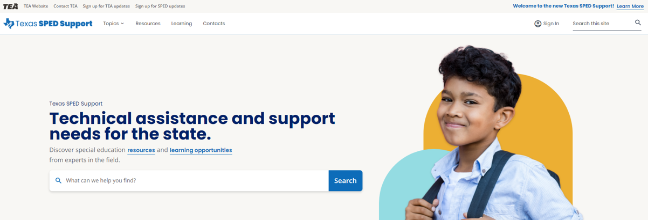
Transition and Technical Assistance

Slide 6
IDEA 2004
Purpose of Special Education
“To ensure that all children have available to them a free and appropriate public education that emphases special education and related services designed to meet their unique needs and prepare them for further education, employment, and independent living.”
34 CFR §300.1(a)

Slide 7
Texas Administrative Code (TAC)-Revised July 26, 2024
TAC §89.1055 Individualized Education Program
(k)Not later than the first IEP to be in effect when the student turns 14 years of age, the ARD committee must consider and, if appropriate, address the following issues in the IEP:
(1)appropriate student involvement in the student's transition to life outside the public school system;
(2)appropriate involvement in the student's transition by the student's parents and other persons invited to participate by:
(A)the student's parents; or
(B)the school district in which the student is enrolled;
(3)appropriate postsecondary education options, including preparation for postsecondary-level coursework;
(4)an appropriate functional vocational evaluation;
(5)appropriate circumstances for facilitating a referral of a student or the student's parents to a governmental agency for services or public benefits, including a referral to a governmental agency to place the student on a waiting list for public benefits available to the student such as a waiver program established under the Social Security Act (42 U.S.C. Section 1396n(c)), §1915(c); and
(6)the use and availability of appropriate:
(A)supplementary aids, services, curricula, and other opportunities to assist the student in developing decision-making skills; and
(B)supports and services to foster the student's independence and self-determination, including a supported decision-making agreement under Texas Estates Code, Chapter 1357.

Slide 8
Ard Info slide
(l)Beginning not later than the first IEP to be in effect when the student turns 14 years of age, or younger if determined appropriate by the ARD committee, the IEP must include:
(1)appropriate measurable postsecondary goals based upon age-appropriate transition assessments related to training, education, employment, and, where appropriate, independent living skills; and
(2)the transition services, including courses of study, needed to assist the student in reaching the postsecondary goals.
(m)The goals included in a student's IEP to comply with subsection (l) of this section are intended to comply with the requirements in TEC, §29.011(a)(6) and (8).
(6) appropriate employment goals and objectives;
(8) appropriate independent living goals and objectives;

Slide 9
Ard Info Slide 2
(n)Beginning not later than the first IEP to be in effect when the student turns 18 years of age (see §89.1049 of this title (relating to Parental Rights Regarding Adult Students) for notice requirement of transfer of rights), the ARD committee must consider and, if appropriate, address the following issues in the student's IEP:
(1)involvement in the student's transition and future by the student's parents and other persons, if the parent or other person:
(A)is invited to participate by the student or the school district in which the student is enrolled; or
(B)has the student's consent to participate pursuant to a supported decision-making agreement under Texas Estates Code, Chapter 1357; and
(2)the availability of age-appropriate instructional environments, including community settings or environments that prepare the student for postsecondary education or training, competitive integrated employment, or independent living, in coordination with the student's transition goals and objectives.
(o)A student's ARD committee shall review at least annually the issues described in subsections (k), (l), and (n) of this section and, if necessary, update the portions of the student's IEP that address those issues.

Slide 10
Texas Administrative Code (TAC)
§89.1035. Age Ranges for Student Eligibility (revised)
(a) Pursuant to state and federal law, services provided in accordance with this subchapter must be available to all eligible students ages 3-21. Services will be made available to eligible students on their third birthday. Graduation pursuant to §89.1070(b)(1), of this title (relating to Graduation Requirements) or meeting maximum age eligibility terminates a student's eligibility to receive services in accordance with this subchapter. An eligible student receiving special education services who is 21 years of age on September 1 of a school year will be eligible for services through the end of that school year or until graduation with a diploma pursuant to §89.1070 of this title, whichever comes first.
(b) In accordance with Texas Education Code, §§29.003, 30.002(a), and 30.081, a free appropriate public education must be available from birth to students with visual or auditory impairments.

Slide 11
Texas Administrative Code (TAC)
§89.1049. Parental Rights Regarding Adult Students. (revised)
(a) (b) (c) (d) (e) In accordance with 34 Code of Federal Regulations (CFR), §300.320(c) and §300.520, and Texas Education Code (TEC), §29.017, beginning at least one year before a student reaches 18 years of age, the student's individualized education program (IEP) must include a statement that the student has been informed that, unless the student's parent or other individual has been granted guardianship of the student under the Probate Code, Chapter XIII, Guardianship, all rights granted to the parent under the Individuals with Disabilities Education Act (IDEA), Part B, other than the right to receive any notice required under IDEA, Part B, will transfer to the student upon reaching age 18. The IEP must also state that the student has been provided information and resources regarding guardianship, alternatives to guardianship, including a supported decision-making agreement under Texas Estates Code, Chapter 1357, and other supports and services that may enable the student to live independently. After the student reaches the age of 18, except as provided by subsection (b) of this section, the school district shall provide any notice required under IDEA, Part B, to both the adult student and the parent.
In accordance with 34 CFR, §300.520(a)(3), a school district must notify in writing the adult student and parent of the transfer of parental rights, as described in subsections (a) and (b) of this section, at the time the student reaches the age of 18. This notification is separate and distinct from the requirement that the student's IEP include a statement relating to the transfer of parental rights beginning at least one year before the student reaches the age of 18. This notification is not required to contain the elements of notice referenced in 34 CFR, §300.503, but must include a statement that parental rights have transferred to the adult student. The notice must also include information and resources regarding guardianship, alternatives to guardianship, including a supported decision-making agreement under Texas Estates Code, Chapter 1357, and other supports and services that may enable the student to live independently, and must provide contact information for the parties to use in obtaining additional information.

Slide 12
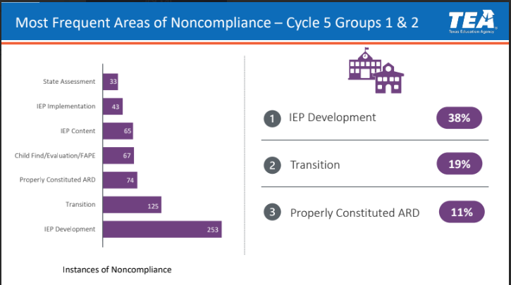
Most frequent areas of noncompliance

Slide 13
The Transition Process
Age-Appropriate Transition Assessments
Interests, Preferences,
Needs, Strengths
IEP Present Levels of Achievement and Performance
Measurable Post-Secondary
Goals
Education/Training, Employment, Independent Living
IEP Annual
Goals
Courses of Study
Instruction,
Related Services, Community Experiences
Coordinated Set of Activities
Agency Linkages
Summary of
Performance

Slide 14
Stephen Covey Quote
“To Begin with the end in mind means to start with a clear understanding of your destination. It means to know where you’re going so that you better understand where you are now so that the steps you take are always in the right direction.”
-Stephen Covey-The Seven Habits of Highly Effective People.
14

Slide 15
TEA-Transition and Employment Guide
Texas Transition and Employment Guide
15

Slide 16
“Next Steps to Independence: Skills and Strategies”

Slide 17
Memorandum of Understanding: TWC-TEA
Duration of the Agreement
September 1, 2022 through August 31, 2027

Slide 18
Section 1 - Purpose of the TWC-TEA MOU An agreement to provide VR Transition Services to students with disabilities to assist them to enter CIE)
The agreement seeks to:
Increase coordination to identify and prepare students with disabilities to move to post-secondary education and or CIE
Improve transition planning to facilitate the development and implementation for the IEP
Establish and periodically update a mechanism to identify the areas of the state with the greatest needs for VR transition services
Institute a mechanism to ensure VR staff can attend ARD committee meetings when invited and as appropriate
Provide information about roles and responsibilities include financial responsibilities
Strengthen relationships to facilitate successful outcomes for students with disabilities.

Slide 19
Section 2 – Definitions in the Agreement
Vocational Rehabilitation
Graduation
TWC
LEA
WIOA
IPE
IDEA
IEP
CIE
WITW
VR Pre-ETS
Student with a Disability
TEA
ESC
Potentially Eligible
VR Transition Services
ARD

Slide 20
Group Activity: MOU Review
Pull copy of the MOU between TWC-TEA in your conference packet
We want to ensure we have at eat table, a mixed group of TWC-VR staff as well as our School Partners
Decide what questions you have and highlight 1-2 of them
Identify a person from within your group who will share out your questions
Any pending questions: Place in the “Parking Lot”

Slide 21
VR School Plan Guidelines

Slide 22
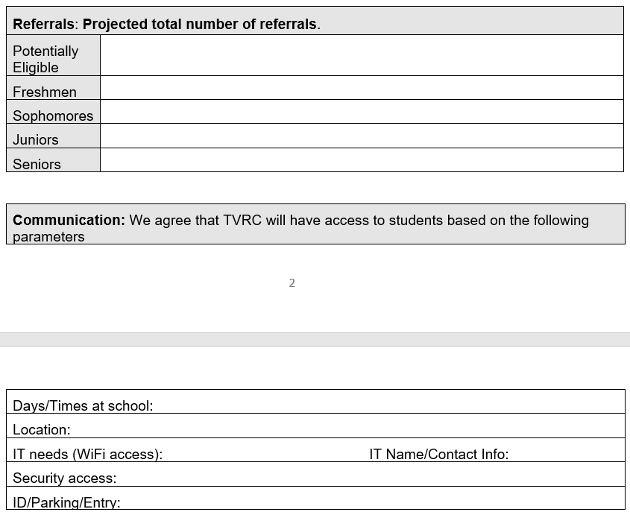
School Plan Slide

Slide 23
School Plan Slide 2

Slide 24
Capacity Building for a Stronger Collaboration
Collaboration and Communication for student success
How systems benefit from seamless transition collaboration
What are Pre-Employment Transition Services (Pre-ETS)
How ISD Staff can initiate contact with VR Staff
Starting the student referral process
Two Pathways to Vocational Rehabilitation Services:
(1) Potentially VR Eligible and (2) VR Eligible
When to enter into each VR Phase?
Review of the Potentially Eligible Process

Slide 25
Importance of Collaboration
Collaboration is a predictor of positive postschool outcomes for students with disabilities when it occurs across education, vocational rehabilitation, families, and numerous other partners who provide instruction, pre-employment transition services, and other transition services stakeholders.
Well-developed partnerships for planning and service delivery give the greatest benefit to youth and their families.
Source: Interagency Collaboration - NTACT:C (transitionta.org)

Slide 26
Seamless Transition Collaboration How Systems Benefit
Education
More meaningful Individualized Education Program (IEP) and transition plans required under the Individuals with Disabilities Education Act (IDEA);
Additional positive outcomes required by IDEA Indicator 14 reports, and post-school follow up shows more former students working.
More meaningful 504 Plans required under the 504 Rehabilitation Act.
Vocational Rehabilitation
Clear opportunities to meet WIOA requirements to collaborate with education agencies;
More successful case closures, that is, services to youth with I/DD and other significant disabilities result in successful employment.
State I/DD and Other Service Agencies
More efficient application of resources when providing services to youth who exit school already working.

Slide 27
VRSM Policy Overview of VR Services Part C, Chapter 21: Scope of Services
Pre-Employment Transition Services (Pre-ETS):
Services available only to those who meet the definition of students with disabilities; and
VR Services:
Services for customer who have applied for or have been determined eligible, and consistent with each individual’s IPE.
Here are a few examples:
Assessment for determining services
VR Counseling and Guidance
Transportation Services
Interpreter and Reader Services
Employment-related Services
Supported Employment Services
Transition Services

Slide 28
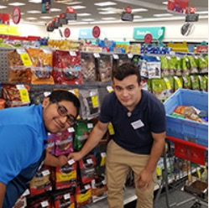
Pre-Employment Transition Services
WIOA (July 2014) utilizes the term:
“Pre-Employment Transition Services” as the type of services that are most impactful for students with disabilities.
These services help customers prepare for employment opportunities. They come before actual employment and cease at that time.
Self-advocacy
Career exploration
Workplace readiness training
Work-based learning experiences
Counseling on post-secondary options

Slide 29
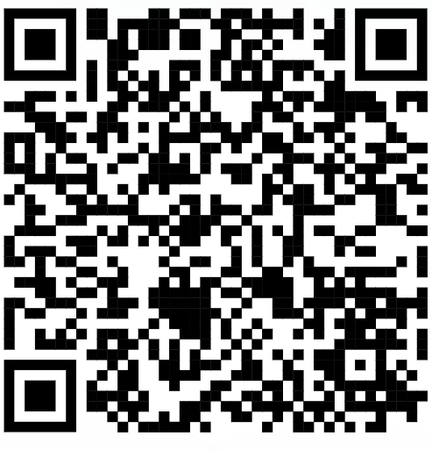
Initiating Contact with Your VR Office
Contact your assigned TVRC or VRC High School Liaison
Call VR Inquiries at (512) 936-6400
Use VR Office Locator website to find an office near you
Email vr.office.locator@twc.texas.gov with your name, phone number, and address
Engage with your local Regional Transition Program Specialist to find appropriate counselor

Slide 30
Submitting an Online Self-Referral
If there is no other way for a student or the referring party to connect with VR staff, there is the option for an online self- referral.
Before taking advantage of this option, it should be noted that the customer’s information is being put into the system and then transferred until it is with the correct staff person to handle the case.
This process may take much longer than a traditional referral, due to the referral coming through a different channel of communication.

Slide 31
Submitting an Online Self-Referral (Continued)
Start My VR – Online Self-Referral

Slide 32
Supplementing vs Supplanting
VR should not cover items included on the student’s IEP because this is the school’s responsibility under IDEA.
All services VR provides must be reasonable and necessary for the student to reach employment goal.
When gray areas in services arise, it is best to meet and discuss the need so that the two agencies can partner and pool resources.
Example of gray area: Work Experience supported by both the school and Vocational Rehabilitation.

Slide 33
Student Referral Process
School staff have the option to submit a VR 2002 Referral Form for each student referral; signatures are not required for this form.
In addition, school staff also have the option to submit school records and reports upon signed release from student/guardian.
School staff and VR Counselor set up a meeting to discuss student referrals, pertinent information is obtained to start the understanding of student's needs.
Appropriate Referrals:
SPED Students
504 Students
18+ Students
Career and Technical Education (CTE) Students
Students who have not disclosed their disability, but Teachers/Nurses see needs on campus.
NOTE: The VR 1820 form is not completed by school staff.

Slide 34
Student Referral Process (continued)
Counselor should contact student and parent to determine appropriate services where information is obtained to further understand the student’s needs and for the counselor to explain the purpose of the VR program.
Depending on the type of appropriate services, VR Counselors will follow the Potentially Eligible Process or the VR Application Process, by placing the student in Initial Contact with Case Assignment on the corresponding caseload.
If the student will go through the Potentially Eligible Process, a VR 1820 can be submitted. Only one VR 1820 form is necessary for the life of the case.
If the student will go through the VR Application Process, an application appointment is scheduled within 30 days.

Slide 35
VRS: ARD Meeting Participation
ARD= Admission, Review, Dismissal
TVRC’s and VRC’s are beholden to participate in ARD meetings when invited within a certain amount of time, specified in the TEA/TWC Memorandum of Understanding. If a student has already been referred to VR, school staff can document the referral has been completed to fulfill the ARD request requirement.
“Participation” can look differently based on needs of school and availability of counselor (phone call, virtual, written statement, in person attendance). It is important to discuss appropriate times to ask for VR participation in ARDs.
School Plans done at the start of the year can be instrumental in planning for counselor participation in this meeting.

Slide 36
LEA: ARD Meeting Participation
ARD= Admission, Review, Dismissal | Communication with T/VRC | Consent from Parents | Postsecondary Goals Outcomes
ARD Participation is separate from monthly contact | Best Practice schedule ARD meetings on the days the T/VRC is on campus (when possible)
“Participation” does not mean physical, in-person participation. MOU states to provide 30 days’ notice, when possible, to invite a T/VRC to attend meeting.
Share and communicate ARD Annual Schedule with T/VRC (Name, Grade, and Date). Consider Prep Days hosted by the school.

Slide 37
Two Pathways to Vocational Rehabilitation Services
VR Eligible Pathway
Potentially Eligible Pathway
Note: Pre-ETS are provided to individuals who meet the definition of a student with a disability and are eligible or potentially eligible for VR services.
VRSM Policy Reference
C-1305-10: Working with Potentially Eligible Students

Slide 38
Who is considered Potentially Eligible?
To receive Pre-ETS and be considered potentially eligible for VR services, an individual must meet only the definition of a student with a disability.
The only VR requirements that are applied to potentially eligible individuals are informed choice, confidentiality, and access to the client assistance program (34 CFR §361.38, §361.52, and §361.56).
Potentially eligible students are not subject to Basic Living Requirements or other cost sharing requirements.
A student who has not yet applied or been made eligible for VR services.
VRSM Policy Reference
Part C, Chapter 8.1: Pre-Employment Transition Services Procedures – A. Working with Potentially Eligible Students

Slide 39
VRSM Policy Part C – Chapter 8.1 Pre-ETS : Student with a Disability
Based on federal regulations (34 CFR §361.5(c) (51)), in Texas, a student with a disability is defined as an individual between the ages of 14 and 22 who is:
enrolled in a recognized educational program, which may include public schools (including charter schools), private schools, home schools, recognized post-secondary programs, or other recognized settings, such as the schooling provided by juvenile justice facilities;
receiving services through the Individuals with Disabilities Education Act (IDEA) (Special Education); or
considered eligible for Section 504 services (includes individuals who are receiving VR services).

Slide 40
Pathway to Potentially VR Eligible
Use Potentially Eligible for a Younger Student When:
The Student will only need Pre-ETS at this time;
The Student has not expressed interest in applying for VR services;
The Student would like to participate in a Pre-ETS activity in the immediate future; or
The Student is at the beginning of their career exploration with limited experience or knowledge of career interests and would benefit from Pre-ETS at this time.

Slide 41
When To Use Potentially Eligible Scenario
Younger Customers seeking Pre-ETS Services only (e.g., 14–16-year-olds requiring minimal supports).
SEAL services without Work Experience Training, Transportation, Uniforms, ASD Supports.
Explore STEM Camps
Contracted Pre-ETS Services
Explore Apprenticeship Program
Students without work permits (i.e., SS cards)
Student that may already have a RHWS a case without assignment (do not duplicate cases).
Student not already entered in RHWS (i.e., IC, Application, Eligibility).

Slide 42
Pathway to VR Eligible
Take an Application for a Younger Student When:
The Student has a need for additional support services which cannot be provided under potentially eligible, such as, work experience training, transportation, and will need Pre-ETS support services (see next slide);
The Student has expressed interest in applying for VR services and does not plan to participate in Pre-ETS immediately; or
The Student has identified their Career Pathway of Interest and will benefit from VR services on an IPE.

Slide 43
Pre-ETS Support Services
Driver’s and Transportation Training - Public Transportation is not always available.
Applied Behavior Analysis (Social Skills Training), Birkman Career Exploration Assessment, and other Autism Supports
Work Experience Training Services

Slide 44
Scenarios VR Eligible Pathways
Student is found eligible for VR services, proceed with VR process (i.e., complete IPE).
Student found ineligible for VR services, will not be able to be placed in Potentially Eligible Phase but can appeal the finding or reapply for full VR services.
Graduating Seniors warranting VR services for post-secondary life.
College Students warranting VR services while in college.
HS student in need of support services.
HS student expressing interest of VR services to address disability.

Slide 45
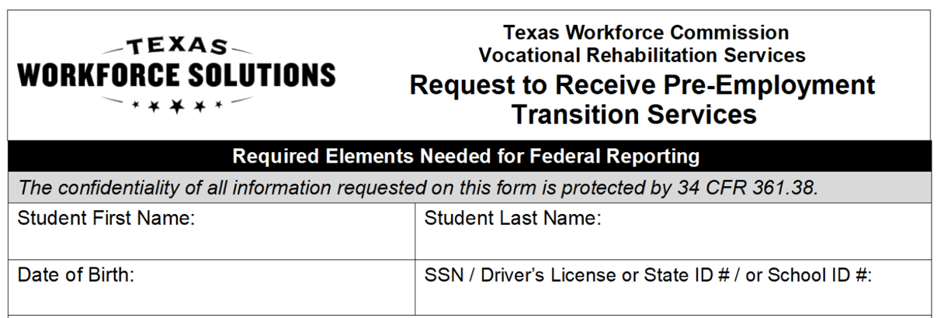
Potentially Eligible Process
Counselor drives the process and completes VR 1820 Request for Pre-ETS form for each student requiring only Pre-Employment Transition Services. Social security number is preferred but other unique identifiers such as State ID or School ID number can be used. Parent or Guardian must sign VR 1820 form if student is underage.
Counselors and school staff can work together to get the VR 1820 forms signed by the student/parent and returned to VR Counselor.

Slide 46
Potentially Eligible Cases Required Documentation To Verify Disability (Policy Reference: VRSM Part C – Chapter 8.1 Pre-ETS)
Supporting documentation that is required to verify the student's disability may include the following:
Case notes documenting VR counselor observations, review of school records, and statements of education staff;
A signed statement from a school professional with the identification of a student's disability and school enrollment status (A template of the VR Disability Verification Letter is available on the Transition Intranet Page);
46

Slide 47
Potentially Eligible Cases Required Documentation To Verify Disability (Policy Reference: VRSM Part C – Chapter 8.1 Pre-ETS)
Continued
A copy of an IEP, Social Security Administration (SSA) beneficiary award letter, school psychological assessment, documentation of a diagnosis or disability determination, or documentation relating to Section 504 accommodations.
Note for VR Staff: Do not use an Eligibility Case Note to document disability for a Potentially Eligible Case. Refer to the new Desk Aide: How to Document a Potentially Eligible Case for guidance regarding how to document a Potentially Eligible case in Rehab Works.
47

Slide 48
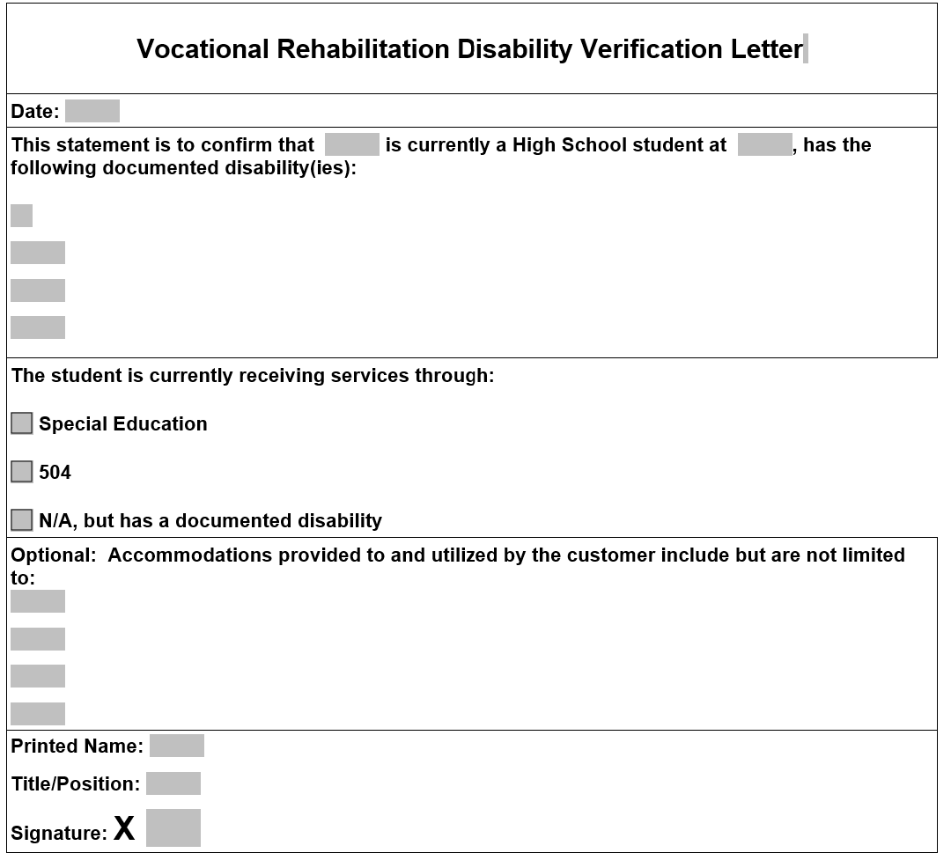
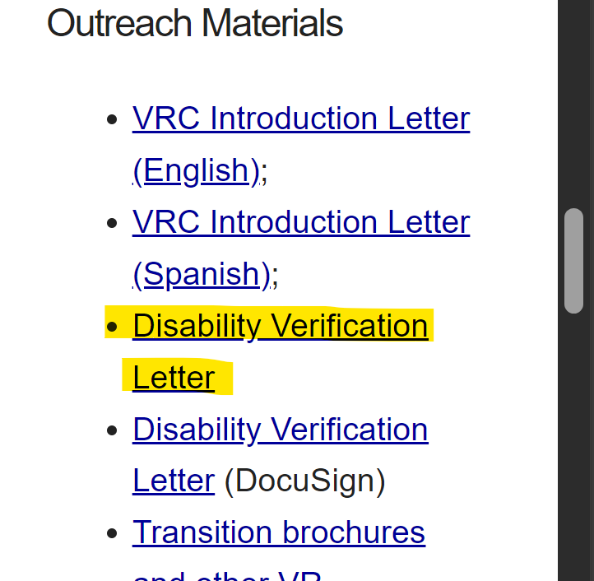
VR Disability Verification Letter on TWS-VRS Transition Intranet Page

Slide 49
Starting The Potentially Eligible Process
Applicable releases are required to share information with school, and parental/guardian consent is required if student is a minor.
VR 5061: Notice and Consent for Disclosure of Personal Information (required)
VR 1517-2: Authorization for Release of Confidential Customer Records and Information for Parents (if the student is not a minor)
VR 1517-2: Authorization for Release of Confidential Customer Records and Information for School (recommended by VR Policy to share information with school)
VR 5060: Permission to Collect Information (required if school records are requested)
For Work-Based Learning, VR staff asks the customer to provide original unexpired documents that prove his or her identity and show that the customer can work legally in the United States. Examples of work-based learning placement include:
SEAL
Placements through Paid or Unpaid Work Experience

Slide 50
Potentially Eligible Process (continued)
Counselors provide students with “Can We Talk” Brochure for informed choice and appeal procedures.
Counselor completes any needed Service Justification and Service Authorizations for services provided in PE phase.
Potentially eligible students may immediately engage in pre-employment transition services as well as apply for the full range of VR services.
Counselor documents case notes on customer progress in all Pre-ETS.
Counselor works with student/parents and Pre-ETS vendor to determine the need for additional Pre-ETS versus the need for additional supports and VR application.

Slide 51
Potentially Eligible Cases: Case Notes Policy Reference: VRSM Part C – Chapter 8.1 Pre-ETS
The TVRC or VR counselor assigned to the potentially eligible case must enter case notes in RHW that document information about the student, justification for services, progress, and outcomes. Topics that must be documented in one case or multiple case notes, when applicable, are:
a description of the disability, functional limitations, and counselor observations; we should add corresponding case notes, as it can be confusing.
a record of the disability from the student’s perspective;

Slide 52
Potentially Eligible Cases: Case Notes Policy Reference VRSM Part C – Chapter 8.1 Pre-ETS (continued)
counseling and guidance and other Pre-ETS provided directly by the VR counselor;
a service justification case note that indicates the planned services, including the type of, and rationale for, Pre-ETS; and
the skills gained, as well as other progress made by the student as a result of receiving Pre-ETS
For More information on Pre-ETS case notes and activities, reference TWC Desk Aide for Potentially Eligible Vocational Rehabilitation Division: Transition Services for Students and Youth with Disabilities (texas.gov) and the new Desk Aide: How to Document a Potentially Eligible Case.

Slide 53
PE Case Scenario

Slide 54
VR Process Timeline
54

Slide 55
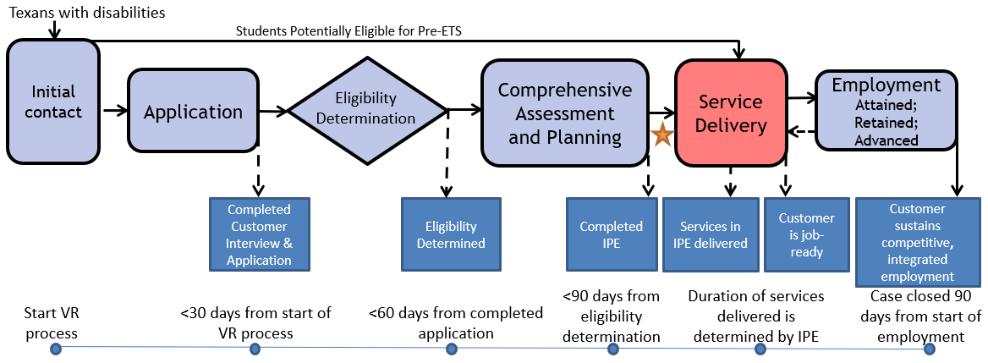
The VR Process and Timelines
30 → 60 → 90-day timelines

Slide 56
Common Forms and When to Use Them
VR 5060 Permission to Collect Information | A customer authorizes VR to collect information or records from an individual or entity. A customer completes an application and: An individual at a 14c is interested in applying for VR services, VR is requesting records or information, or VR discloses records to a juvenile service provider. | The release is valid for 365 days from the date signed, or until the date when the VR case is closed, whichever date occurs earlier.
VR 5061 Notice and Consent for Disclosure of Personal Information | A customer acknowledges that VR may need to disclose personal information or records to other organizations for purposes directly connected with the administration of their VR services. At application and initial contact without case assignment for potentially eligible. A customer’s file contains alcohol and drug abuse patient records. | No expiration

Slide 57
Common Forms and When to Use Them (Cont’d)
VR 2002 Referral Form | General Referral Form Does not require signature | No expiration
VR 1820 Request to Receive Pre-ETS | Request for Pre-ETS services only Can serve as a referral form. Must be filled out prior to receipt of any Pre-Employment Transition Services. | No expiration; New form is not required each school year.
VR 1487 Designation of Representative | Needed for students that are underage or have a guardian | No expiration; Continues until counselor is notified in writing that it is no longer in effect.

Slide 58
Common Forms and When to Use Them (Cont’d )
VR1517-2 Authorization for Release of Confidential Customer Records and Information | A customer authorizes VR to release confidential records and information to a person(s) or entity. A customer with no guardian would like for a person that he chooses to be present during appointments with the VR counselor. A transition student would like his counselor to discuss his specific accommodation needs with potential employers. | The release is valid until revoked by the customer or until the date when the customer ceases to be a VR applicant or customer, whichever date occurs earlier.
VR 5063 Permission to Collect and Notice to Disclose - National Student Clearinghouse | The purpose of the VR5063 is to document a customer’s consent to exchange information with National Student Clearinghouse, a source that houses post-secondary student data. The credential information received from National Student Clearinghouse may be used to satisfy reporting and documentation requirements for federal performance measures related to credential attainment. | No expiration

Slide 59
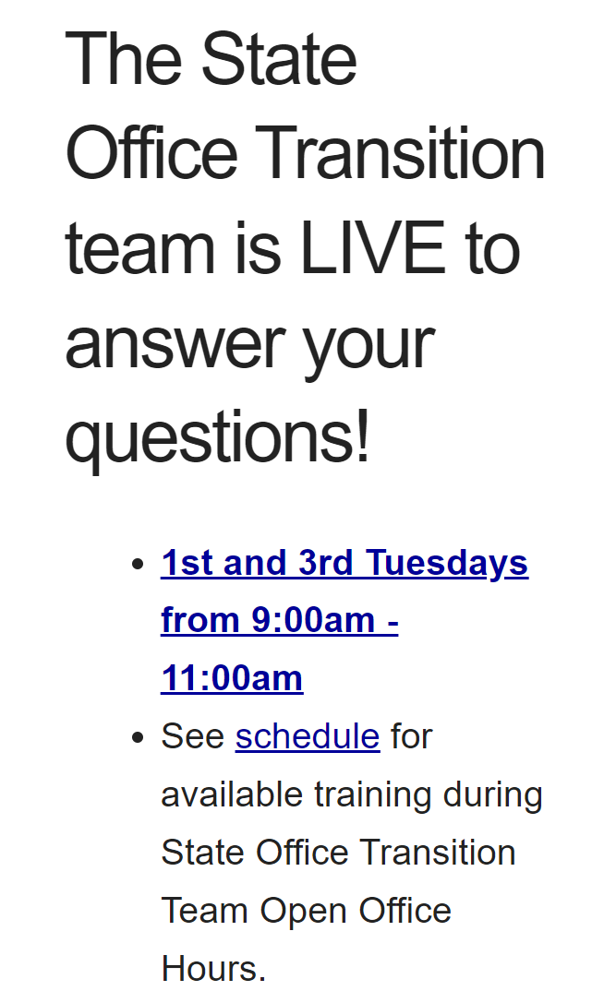
Contact Information and Pre-ETS Office Hours
VR Pre-ETS Mailbox
VR.Pre-ETS@twc.texas.gov

Slide 60
Use AskTED ESC Search Screen (state.tx.us) to find your Educational Service Center Contacts

Slide 61
Regional Transition Specialists
Region 1 West Texas Andrew Castillo 915-834-7701 Andrew.Castillo@twc.texas.gov | Region 3 Central Texas Judy Siebel 512-820-1765 Judy.Siebel@twc.texas.gov | Region 5 Houston Janeen Gordon 832-840-2946 Janeen.Gordon@twc.texas.gov
Region 2 Dallas/Ft Worth Rosla Hocker 817-436-4127 Rosla.Hocker@twc.texas.gov | Region 4 East Texas Kirstin Johnson 903-504-9531 Kirstin.Johnson@twc.texas.gov | Region 6 South Texas Rebecca Quintero 210-238-3592 Rebecca.Quintero@twc.texas.gov

Slide 62
State Office Transition Team
Erin Wilder Program Manager 512-936-3707 Erin.Wilder@twc.texas.gov | Kevin Markel Program Specialist 817-727-9045 Kevin.Markel@twc.texas.gov | Alyssa Kee Program Specialist 915-217-8188 Alyssa.Kee@twc.texas.gov | Kristen Davis Program Specialist 512-221-9071 Kristen.Davis@twc.texas.gov
Laura Villarreal Neurodevelopmental Specialist 512-541-6439 Laura.Villarreal@twc.texas.gov | Leigh Ann Godinez Program Specialist 512-720-8347 Leighann.Godinez@twc.texas.gov | Gabriela Martinez Program Specialist 956-566-1228 Gabriela.Martinez@twc.texas.gov | Team Mailbox VR.Pre-ETS@twc.texas.gov

Slide 63
Questions

Slide 64
Texas Workforce Solutions-Vocational Rehabilitation Services
101 East 15th Street
Austin, Texas 78778-0001
512-936-6400
VR.office.locator@twc.state.tx.us
Equal Opportunity Employer/Program
Auxiliary aids and services are available upon request to individuals with disabilities.
The Texas Workforce Commission accepts calls made
through any relay service provider.
www.twc.texas.gov

Slide 65
Federal Funding
These activities are financed under the TWC Federal Vocational Rehabilitation grant. For the Federal fiscal year 2024 (October 1, 2023, through September 30, 2024), TWC anticipates expending $320,291,817 in Federal Vocational Rehabilitation funds. Funds appropriated by the State pay a minimum of 21.3% of the total costs ($86,686,349) under the Vocational Rehabilitation program. Revised June 2024.
For purposes of the Supported Employment program, the Vocational Rehabilitation agency receives 94.7 percent of its funding through a grant from the U.S. Department of Education. For the 2024 Federal fiscal year, the total amount of grant funds awarded are $1,501,230. The remaining 5.3 percent ($83,402) are funded by Texas State Appropriations. Revised June 2024.
For purposes of the Independent Living Services for Older Individuals who are Blind program, the Vocational Rehabilitation agency receives 90 percent of its funding through a grant from the U.S. Department of Education. For the 2024 Federal fiscal year, the total amount of grant funds awarded are $2,213,488. The remaining 10 percent ($245,943) are funded by Texas State Appropriations. Revised June 2024.

