Slide 1
Pre-ETS Regional Training Breakouts VR Region 1 ESC 9,14,15,16,17,18,19
Statewide Capacity Building Conference
Frisco, TX
October 2024

Slide 2
Capacity Building for a Stronger Collaboration
Collaboration and Communication for student success
How systems benefit from seamless transition collaboration
What are Pre-Employment Transition Services (Pre-ETS)
How ISD Staff can initiate contact with VR Staff
Starting the student referral process
Two Pathways to Vocational Rehabilitation Services:
(1) Potentially VR Eligible and (2) VR Eligible
When to enter into each VR Phase?
Review of the Potentially Eligible Process

Slide 3
Introductions
Andrew Castillo, Region 1 Transition VR
Alyssa Kee, State Office Transition VR
Leah Wood, ESC 19

Slide 4
Importance of Collaboration
Collaboration is a predictor of positive postschool outcomes for students with disabilities when it occurs across education, vocational rehabilitation, families, and numerous other partners who provide instruction, pre-employment transition services, and other transition services stakeholders.
Well-developed partnerships for planning and service delivery give the greatest benefit to youth and their families.
Source: Interagency Collaboration - NTACT:C (transitionta.org)

Slide 5
Seamless Transition Collaboration How Systems Benefit
Education
More meaningful Individual Education Plans (IEP) and transition plans required under the Individuals with Disabilities Education Act (IDEA);
Additional positive outcomes required by IDEA Indicator 14 reports, and post-school follow up shows more former students working.
More meaningful 504 Plans required under the 504 Rehabilitation Act.
Vocational Rehabilitation
Clear opportunities to meet WIOA requirements to collaborate with education agencies;
More successful case closures, that is, services to youth with I/DD and other significant disabilities result in successful employment.
State I/DD and Other Service Agencies
More efficient application of resources when providing services to youth who exit school already working.

Slide 6
Key Areas for Improved Collaboration
Early Identification and Referral:
Challenge: Lack of timely identification of students who could benefit from VR services.
Solution: Streamline referral processes between school districts and TWC to ensure earlier interventions.
Shared Data and Resources:
Challenge: Limited sharing of relevant student data between TWC and school districts.
Solution: Establish clear protocols for data sharing to better tailor services to individual student needs, in compliance with FERPA.
Joint Professional Development:
Challenge: Educators and VR counselors often work in silos.
Solution: Offer joint training opportunities on transition planning, special education, and VR services.

Slide 7
Collaboration Through Transition Planning
Individualized Education Program (IEP) & Individualized Plan for Employment (IPE):
Encourage VR counselors to attend IEP meetings to coordinate IPE development.
Align IEP and IPE goals to create a seamless transition from school to work.
Work-Based Learning Integration:
Increase opportunities for students to participate in work-based learning as part of their IEP goals.
Collaborate with employers to provide real-world training and internships.

Slide 8
Collaboration Issues
ISD’s unable to able to identify the assigned VR counselor
Limited capacity on VR caseloads and certain programs
Deadlines for programs not being communicated
VR applications delayed or not taken
Program capacities and slots not uniformly allotted (ex. SEAL)
Planning/coordination of programs hindered due to apprehension of supplanting services

Slide 9
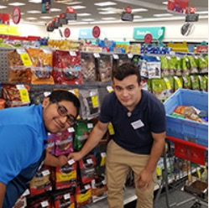
Pre-Employment Transition Services
WIOA (July 2014) utilizes the term:
“Pre-Employment Transition Services” as the type of services that are most impactful for students with disabilities.
These services help customers prepare for employment opportunities. They come before actual employment and cease at that time.
Career exploration
Self-advocacy
Workplace readiness training
Work-based learning experiences
Counseling on post-secondary options

Slide 10
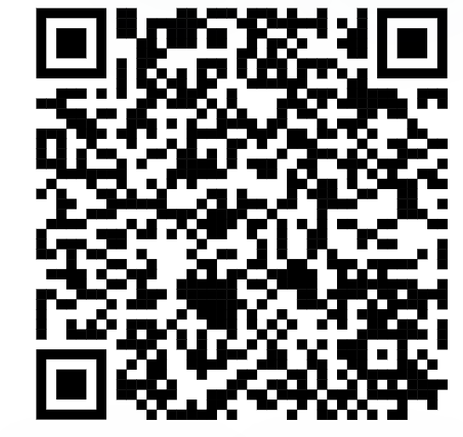
Initiating Contact with Your VR Office
Contact your assigned TVRC or VRC High School Liaison
Call VR Inquiries at (512) 936-6400
Use VR Office Locator website (find an office near you)
Email vr.office.locator@twc.texas.gov with your name, phone number, and address
Engage with your local Regional Transition Program Specialist to find appropriate counselor

Slide 11
Submitting an Online Self-Referral
If there is no other way for a student or the referring party to connect with VR staff, there is the option for an online self- referral.
Before taking advantage of this option, it should be noted that the customer’s information is being put into the system and then transferred until it is with the correct staff person to handle the case.
This process may take much longer than a traditional referral, due to the referral coming through a different channel of communication.

Slide 12
Submitting an Online Self-Referral (Continued)
Start My VR – Online Self-Referral

Slide 13
Supplementing vs Supplanting
VR should not cover items included on the student’s IEP because this is the school’s responsibility under IDEA.
All services VR provides must be reasonable and necessary for the student to reach employment goal.
When gray areas in services arise, it is best to meet and discuss the need so that the two agencies can partner and pool resources.
Example of gray area: Work Experience supported by both the school and Vocational Rehabilitation.

Slide 14
Student Referral Process
School staff have the option to submit a VR 2002 Referral Form for each student referral; signatures are not required for this form.
In addition, school staff also have the option to submit school records and reports upon signed release from student/guardian.
School staff and VR Counselor set up a meeting to discuss student referrals, pertinent information is obtained to start the understanding of student's needs.
Appropriate Referrals:
SPED Students
504 Students
18+ Students
Career and Technical Education (CTE) Students
Students who have not disclosed their disability, but Teachers/Nurses see needs on campus.
NOTE: The VR 1820 form is not completed by school staff.

Slide 15
Student Referral Process (continued)
Counselor should contact student and parent to determine appropriate services where information is obtained to further understand the student’s needs and for the counselor to explain the purpose of the VR program.
Depending on the type of appropriate services, VR Counselors will follow the Potentially Eligible Process or the VR Application Process, by placing the student in Initial Contact with Case Assignment on the corresponding caseload.
If the student will go through the Potentially Eligible Process, a VR 1820 can be submitted. Only one VR 1820 form is necessary for the life of the case.
If the student will go through the VR Application Process, an application appointment is scheduled within 30 days.

Slide 16
ARD Meeting Participation
ARD= Admission, Review, Dismissal
TVRC’s and VRC’s are beholden to participate in ARD meetings when invited within a certain amount of time, specified in the TEA/TWC Memorandum of Understanding. If a student has already been referred to VR, school staff can document the referral has been completed to fulfill the ARD request requirement.
“Participation” can look differently based on needs of school and availability of counselor (phone call, virtual, written statement, in person attendance). It is important to discuss appropriate times to ask for VR participation in ARDs.
School Plans done at the start of the year can be instrumental in planning for counselor participation in this meeting.

Slide 17
Goals of the MOU between TWC & TEA
Improved Transition Services:
Support students with disabilities transitioning from high school to postsecondary education or employment.
Increased Access to Vocational Rehabilitation Services:
Ensure students with disabilities can access VR services during high school to prepare for the workforce.
Collaborative Planning and Communication:
Strengthen collaboration between school districts, VR counselors, and other stakeholders.

Slide 18
Roles and Responsibilities Under the MOU
School Districts:
Identify students with disabilities who may benefit from VR services.
Collaborate with VR counselors to integrate VR services into students’ IEPs.
ESC:
Provide guidance to school districts on the implementation of the MOU.
Help make the connection with TEA to monitor district compliance with the collaboration provisions outlined in the MOU.

Slide 19
School Plans
The School Plan is a great tool for establishing procedures and accountability with schools. This can be a valuable tool in establishing and maintaining effective partnerships with schools.
Key components for the School Plan include:
Relevant points of contact for TWC and the ISD
Joint goals for the school year
Overview of the referral and communication processes, including follow up
Opportunities for collaboration
Parents night, career fair, group orientations, etc.
Processes for data tracking and storage

Slide 20
Two Pathways to Vocational Rehabilitation Services
VR Eligible Pathway
Potentially Eligible Pathway
Note: Pre-ETS are provided to individuals who meet the definition of a student with a disability and are eligible or potentially eligible for VR services.
VRSM Policy Reference
C-1305-10: Working with Potentially Eligible Students

Slide 21
Who is considered Potentially Eligible?
Working with Potentially Eligible Students
To receive Pre-ETS and be considered potentially eligible for VR services, an individual must meet only the definition of a student with a disability.
The only VR requirements that are applied to potentially eligible individuals are informed choice, confidentiality, and access to the client assistance program (34 CFR §361.38, §361.52, and §361.56).
Potentially eligible students are not subject to Basic Living Requirements or other cost sharing requirements.
VRSM Policy Reference
C-1305-10: Working with Potentially Eligible Students

Slide 22
VRSM Part C – Chapter 8.1 Pre-ETS : Student with a Disability
Based on federal regulations (34 CFR §361.5(c) (51)), in Texas, a student with a disability is defined as an individual between the ages of 14 and 22 who is:
enrolled in a recognized educational program, which may include public schools (including charter schools), private schools, home schools, recognized post-secondary programs, or other recognized settings, such as the schooling provided by juvenile justice facilities;
receiving services through the Individuals with Disabilities Education Act (IDEA) (Special Education); or
considered eligible for Section 504 services (includes individuals who are receiving VR services).

Slide 23
Pathway to Potentially VR Eligible
Use Potentially Eligible for a Younger Student When:
The Student will only need Pre-ETS at this time;
The Student has not expressed interest in applying for VR services;
The Student would like to participate in a Pre-ETS activity in the immediate future; or
The Student is at the beginning of their career exploration with limited experience or knowledge of career interests and would benefit from Pre-ETS at this time.

Slide 24
When To Use Potentially Eligible Scenario
Younger Customers seeking Pre-ETS Services only (e.g., 14–16-year-olds requiring minimal supports).
SEAL services without support services (on-site training, transportation, etc.)
Explore STEM Camps
Contracted and Embedded Pre-ETS Services
Explore Apprenticeship Program
Students without work permits (i.e., SS cards)
Student that may already have a RHW a case without assignment (do not duplicate cases).
Student not already entered in RHW (i.e., IC, Application, Eligibility).

Slide 25
Pre-ETS Support Services
Driver’s and Transportation Training - Public Transportation is not always available.
Applied Behavior Analysis (Social Skills Training), Birkman Career Exploration Assessment, and other Autism Supports
Work Experience Training Services

Slide 26
Pathway to VR Eligible
Take an Application for a Younger Student When:
The Student has a need for additional support services which cannot be provided under potentially eligible, such as, work experience training, transportation, and will need Pre-ETS support services (see next slide);
The Student has expressed interest in applying for VR services and does not plan to participate in Pre-ETS immediately; or
The Student has identified their Career Pathway of Interest and will benefit from VR services on an IPE.

Slide 27
Scenarios: VR Eligible Pathways
Student is found eligible for VR services, proceed with VR process (i.e., complete IPE).
Student found ineligible for VR services, will not be able to be placed in Potentially Eligible Phase but can appeal the finding or reapply for full VR services.
Graduating Seniors warranting VR services for post-secondary life.
College Students warranting VR services while in college.
HS student in need of support services.
HS student expressing interest of VR services to address disability.

Slide 28
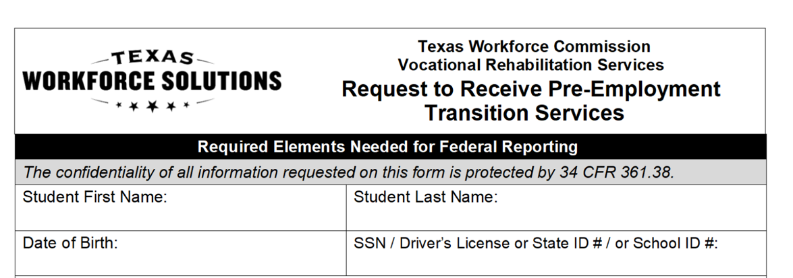
Potentially Eligible Process
Counselor drives the process and completes VR1820 Request for Pre-ETS form for each student requiring only Pre-Employment Transition Services. Social security number is preferred but other unique identifiers such as State ID or School ID number can be used. Parent or Guardian must sign 1820 form if student is underage.
Counselors and school staff can work together to get the 1820 forms signed by the student/parent and returned to VR Counselor.

Slide 29
Potentially Eligible Cases: Required Documentation To Verify Disability (Policy Reference: VRSM Part C – Chapter 8.1 Pre-ETS)
Supporting documentation that is required to verify the student's disability may include the following:
Case notes documenting VR counselor observations, review of school records, and statements of education staff;
A signed statement from a school professional with the identification of a student's disability and school enrollment status (A template of the VR Disability Verification Letter is available on the Transition Intranet Page);

Slide 30
Potentially Eligible Cases: Required Documentation To Verify Disability (Policy Reference: VRSM Part C – Chapter 8.1 Pre-ETS) – Continued
A copy of an IEP, Social Security Administration (SSA) beneficiary award letter, school psychological assessment, documentation of a diagnosis or disability determination, or documentation relating to Section 504 accommodations.
Note for VR Staff: Do not use an Eligibility Case Note to document disability for a Potentially Eligible Case. Refer to the new Desk Aide: How to Document a Potentially Eligible Case for guidance regarding how to document a Potentially Eligible case in Rehab Works.

Slide 31
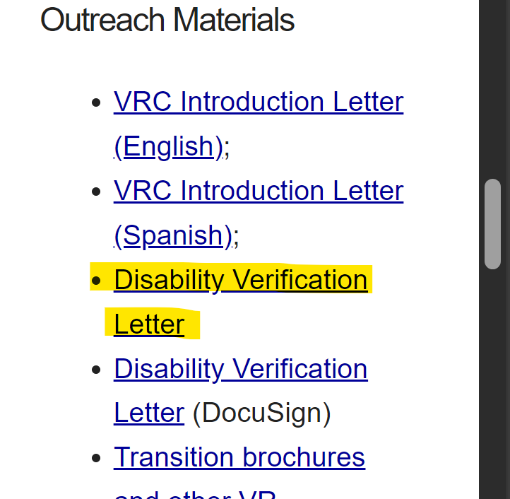
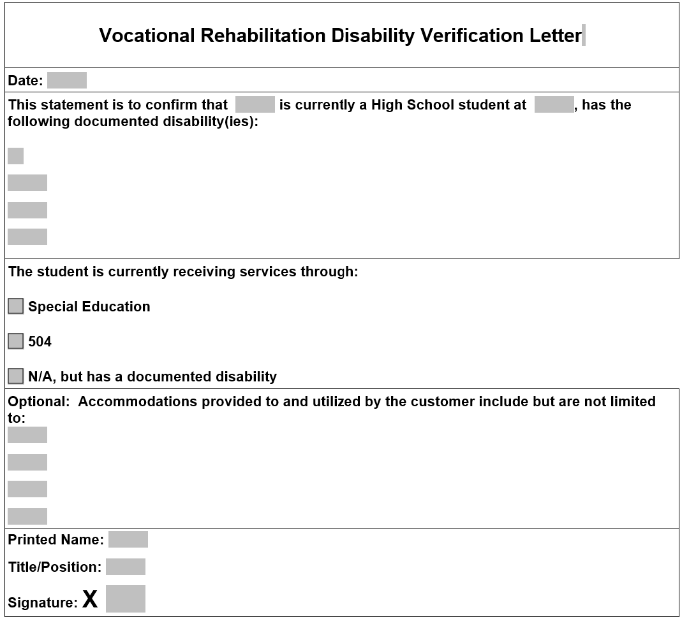
VR Disability Verification Letter on TWS-VRS Transition Intranet Page

Slide 32
Starting The Potentially Eligible Process
Applicable releases are required to share information with school, and parental/guardian consent is required if student is a minor.
VR5061 Notice and Consent for Disclosure of Personal Information (required)
VR1517-2 Authorization for Release of Confidential Customer Records and Information for Parents (if the student is not a minor)
VR1517-2 Authorization for Release of Confidential Customer Records and Information for School (recommended by VR Policy to share information with school)
VR5060 Permission to Collect Information (required if school records are requested)
For Work-Based Learning, VR staff asks the customer to provide original unexpired documents that prove his or her identity and show that the customer can work legally in the United States. Examples of work-based learning placement include:
SEAL
Placements through Paid or Unpaid Work Experience

Slide 33
Potentially Eligible Process (continued)
Counselors provide students with “Can We Talk” Brochure for informed choice and appeal procedures.
Counselor completes any needed Service Justification and Service Authorizations for services provided in PE phase.
Potentially eligible students may immediately engage in pre-employment transition services as well as apply for the full range of VR services.
Counselor documents case notes on customer progress in all Pre-ETS.
Counselor works with student/parents and Pre-ETS vendor to determine the need for additional Pre-ETS versus the need for additional supports and VR application.

Slide 34
Potentially Eligible Cases: Case Notes Policy Reference: VRSM Part C – Chapter 8.1 Pre-ETS
The TVRC or VR counselor assigned to the potentially eligible case must enter case notes in RHW that document information about the student, justification for services, progress, and outcomes. Topics that must be documented in one case or multiple case notes, when applicable, are:
a description of the disability, functional limitations, and counselor observations; we should add corresponding case notes, as it can be confusing.
a record of the disability from the student’s perspective;

Slide 35
Potentially Eligible Cases: Case Notes Policy Reference: VRSM Part C – Chapter 8.1 Pre-ETS(continued)
counseling and guidance and other Pre-ETS provided directly by the VR counselor;
a service justification case note that indicates the planned services, including the type of, and rationale for, Pre-ETS; and
the skills gained, as well as other progress made by the student as a result of receiving Pre-ETS
For More information on Pre-ETS case notes and activities, reference TWC Desk Aide for Potentially Eligible Vocational Rehabilitation Division: Transition Services for Students and Youth with Disabilities (texas.gov) and the new Desk Aide: How to Document a Potentially Eligible Case.

Slide 36
VR Process Timeline

Slide 37
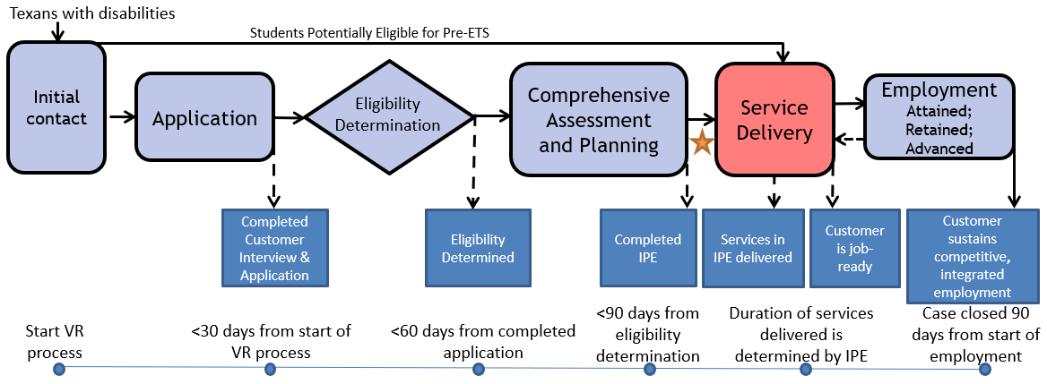
The VR Process and Timelines
30 → 60 → 90-day timelines

Slide 38
Common Forms and When to Use Them
VR5060 Permission to Collect Information | A customer authorizes VR to collect information or records from an individual or entity. A customer completes an application and: An individual at a 14c is interested in applying for VR services, VR is requesting records or information, or VR discloses records to a juvenile service provider. | The release is valid for 365 days from the date signed, or until the date when the VR case is closed, whichever date occurs earlier.
VR5061 Notice and Consent for Disclosure of Personal Information | A customer acknowledges that VR may need to disclose personal information or records to other organizations for purposes directly connected with the administration of their VR services. At application and initial contact without case assignment for potentially eligible. A customer’s file contains alcohol and drug abuse patient records. | No expiration

Slide 39
Common Forms and When to Use Them (Con’t)
VR2002 Referral Form | General Referral Form Does not require signature | No expiration
VR1820 Request to Receive Pre-ETS | Request for Pre-ETS services only Can serve as a referral form. Must be filled out prior to receipt of any Pre-Employment Transition Services. | No expiration; New form is not required each school year.
VR 1487 Designation of Representative | Needed for students that are underage or have a guardian | No expiration; Continues until counselor is notified in writing that it is no longer in effect.

Slide 40
Common Forms and When to Use Them (Continued )
VR1517-2 Authorization for Release of Confidential Customer Records and Information | A customer authorizes VR to release confidential records and information to a person(s) or entity. A customer with no guardian would like for a person that he chooses to be present during appointments with the VR counselor. A transition student would like his counselor to discuss his specific accommodation needs with potential employers. | The release is valid until revoked by the customer or until the date when the customer ceases to be a VR applicant or customer, whichever date occurs earlier.
VR 5063 Permission to Collect and Notice to Disclose - National Student Clearinghouse | The purpose of the VR5063 is to document a customer’s consent to exchange information with National Student Clearinghouse, a source that houses post-secondary student data. The credential information received from National Student Clearinghouse may be used to satisfy reporting and documentation requirements for federal performance measures related to credential attainment. | No expiration

Slide 41
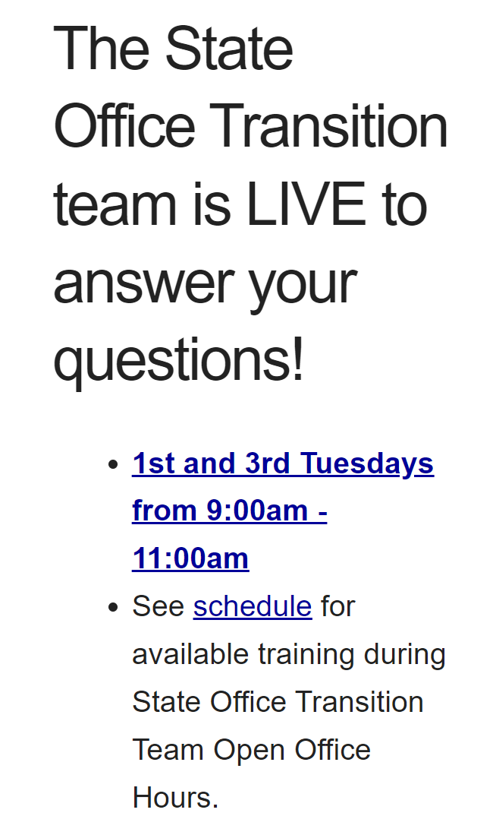
Contact Information and Pre-ETS Office Hours
VR Pre-ETS Mailbox
VR.Pre-ETS@twc.texas.gov

Slide 42
Use AskTED ESC Search Screen (state.tx.us) to find your Educational Service Center Contacts Alternative: Statewide Contacts | Texas SPED Support

Slide 43
Texas Sped Support

Slide 44
State Performance Plan Indicators
SPPI 13 Outcomes
SPPI 13 Looks at transition while the student is in school
All or nothing compliance indicator
8 Questions we have to answer
LEAs must get consent to invite and outside agency
LEAs are required to invite the agencies that will help provide support post-secondary

Slide 45
State Performance Plan Indicators (continued)
SPPI 14 outcomes
SPPI 14: One year post-secondary success
Enrolled in any school, job training, or education program
Contact Office of Disability Services
Supports or accommodations received
Employed full-time or part-time
High school experience most helpful in preparing for employment after high school
High school connect you to any of the following agencies for support while in or out of school

Slide 46
Regional Transition Specialists
Region 1 West Texas Andrew Castillo 915-834-7701 Andrew.Castillo@twc.texas.gov | Region 3 Central Texas Judy Siebel 512-820-1765 Judy.Siebel@twc.texas.gov | Region 5 Houston Janeen Gordon 832-840-2946 Janeen.Gordon@twc.texas.gov
Region 2 Dallas/Ft Worth Rosla Hocker 817-436-4127 Rosla.Hocker@twc.texas.gov | Region 4 East Texas Kirstin Johnson 903-504-9531 Kirstin.Johnson@twc.texas.gov | Region 6 South Texas Rebecca Quintero 210-238-3592 Rebecca.Quintero@twc.texas.gov

Slide 47
State Office Transition Team
Erin Wilder Program Manager 512-936-3707 Erin.Wilder@twc.texas.gov | Kevin Markel Program Specialist 817-727-9045 Kevin.Markel@twc.texas.gov | Alyssa Kee Program Specialist 915-217-8188 Alyssa.Kee@twc.texas.gov | Kristen Davis Program Specialist 512-221-9071 Kristen.Davis@twc.texas.gov
Laura Villarreal Neurodevelopmental Specialist 512-541-6439 Laura.Villarreal@twc.texas.gov | Leigh Ann Godinez Program Specialist 512-720-8347 Leighann.Godinez@twc.texas.gov | Gabriela Martinez Program Specialist 956-566-1228 Gabriela.Martinez@twc.texas.gov | Team Mailbox VR.Pre-ETS@twc.texas.gov

Slide 48
Questions

Slide 49
Texas Workforce Solutions-Vocational Rehabilitation Services
101 East 15th Street
Austin, Texas 78778-0001
512-936-6400
VR.office.locator@twc.state.tx.us
Equal Opportunity Employer/Program
Auxiliary aids and services are available upon request to individuals with disabilities.
The Texas Workforce Commission accepts calls made
through any relay service provider.
www.twc.texas.gov

Slide 50
Federal Funding
These activities are financed under the TWC Federal Vocational Rehabilitation grant. For the Federal fiscal year 2024 (October 1, 2023, through September 30, 2024), TWC anticipates expending $320,291,817 in Federal Vocational Rehabilitation funds. Funds appropriated by the State pay a minimum of 21.3% of the total costs ($86,686,349) under the Vocational Rehabilitation program. Revised June 2024.
For purposes of the Supported Employment program, the Vocational Rehabilitation agency receives 94.7 percent of its funding through a grant from the U.S. Department of Education. For the 2024 Federal fiscal year, the total amount of grant funds awarded are $1,501,230. The remaining 5.3 percent ($83,402) are funded by Texas State Appropriations. Revised June 2024.
For purposes of the Independent Living Services for Older Individuals who are Blind program, the Vocational Rehabilitation agency receives 90 percent of its funding through a grant from the U.S. Department of Education. For the 2024 Federal fiscal year, the total amount of grant funds awarded are $2,213,488. The remaining 10 percent ($245,943) are funded by Texas State Appropriations. Revised June 2024.

