Slide 1
Pre-ETS Regional Training Breakouts
Statewide Capacity Building Conference
Frisco, TX
October 2024

Slide 2


Capacity Building for a Stronger Collaboration
Collaboration and Communication for student success
How systems benefit from seamless transition collaboration
What are Pre-Employment Transition Services (Pre-ETS)
How ISD Staff can initiate contact with VR Staff
Starting the student referral process
Two Pathways to Vocational Rehabilitation Services:
  (1) Potentially VR Eligible and (2) VR Eligible
    When to enter into each VR Phase?
Review of the Potentially Eligible Process

Slide 3
Importance of Collaboration
Collaboration is a predictor of positive postschool outcomes for students with disabilities when it occurs across education, vocational rehabilitation, families, and numerous other partners who provide instruction, pre-employment transition services, and other transition services stakeholders.
Well-developed partnerships for planning and service delivery give the greatest benefit to youth and their families.
Source: Interagency Collaboration - NTACT:C (transitionta.org)

Slide 4
Seamless Transition Collaboration How Systems Benefit
Education
  More meaningful Individual Education Program (IEP) and transition plans required under the Individuals with Disabilities Education Act (IDEA);
  Additional positive outcomes required by IDEA Indicator 14 reports, and post-school follow up shows more former students working.
  More meaningful 504 Plans required under the 504 Rehabilitation Act.
Vocational Rehabilitation
  Clear opportunities to meet WIOA requirements to collaborate with education agencies;
  More successful case closures, that is, services to youth with I/DD and other significant disabilities result in successful employment.
State I/DD and Other Service Agencies
  More efficient application of resources when providing services to youth who exit school already working.

Slide 5
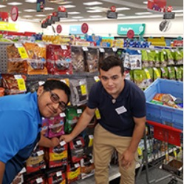
Pre-Employment Transition Services
  WIOA (July 2014) utilizes the term:
  “Pre-Employment Transition Services” as the type of services that are most impactful for students with disabilities.
  These services help customers prepare for employment opportunities. They come before actual employment and cease at that time.
    Career exploration
    Self-advocacy
    Workplace readiness training
    Work-based learning experiences
    Counseling on post-secondary options

Slide 6
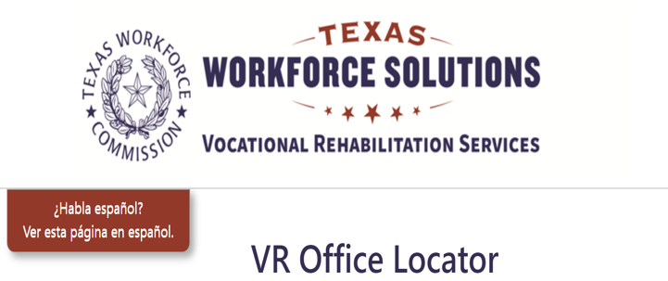
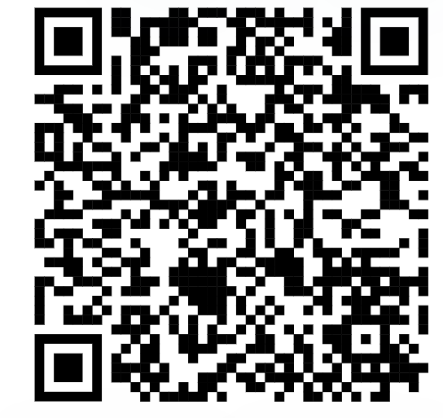
Initiating Contact with Your VR Office
Contact your assigned TVRC or VRC High School Liaison
Call VR Inquiries at (512) 936-6400
Use VR Office Locator website (find an office near you)
Email vr.office.locator@twc.texas.gov with your name, phone number, and address
Engage with your local Regional Transition Program Specialist to find appropriate counselor

Slide 7
Submitting an Online Self-Referral
If there is no other way for a student or the referring party to connect with VR staff, there is the option for an online self- referral.
Before taking advantage of this option, it should be noted that the customer’s information is being put into the system and then transferred until it is with the correct staff person to handle the case.
This process may take much longer than a traditional referral, due to the referral coming through a different channel of communication.

Slide 8
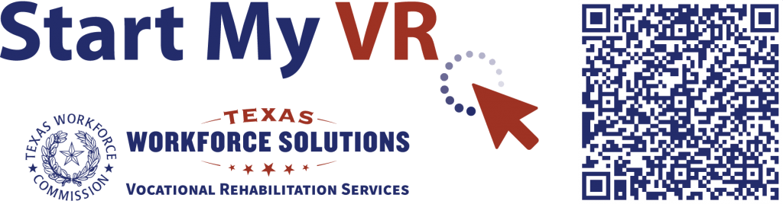
Submitting an Online Self-Referral (Continued)
Start My VR – Online Self-Referral

Slide 9

Supplementing vs Supplanting
VR should not cover items included on the student’s IEP because this is the school’s responsibility under IDEA.
All services VR provides must be reasonable and necessary for the student to reach employment goal.
When gray areas in services arise, it is best to meet and discuss the need so that the two agencies can partner and pool resources.
Example of gray area: Work Experience supported by both the school and Vocational Rehabilitation.

Slide 10


Student Referral Process
School staff have the option to submit a VR 2002 Referral Form for each student referral; signatures are not required for this form.
In addition, school staff also have the option to submit school records and reports upon signed release from student/guardian.
School staff and VR Counselor set up a meeting to discuss student referrals, pertinent information is obtained to start the understanding of student's needs.
Appropriate Referrals:
  SPED Students
  504 Students
  18+ Students
  Career and Technical Education (CTE) Students
  Students who have not disclosed their disability, but Teachers/Nurses see needs on campus.
NOTE: The VR 1820 form is not completed by school staff.

Slide 11
Student Referral Process (continued)
Counselor should contact student and parent to determine appropriate services where information is obtained to further understand the student’s needs and for the cousnelor to explain the purpose of the VR program.
Depending on the type of appropriate services, VR Counselors will follow the Potentially Eligible Process or the VR Application Process, by placing the student in Initial Contact with Case Assignment on the corresponding caseload.
  If the student will go through the Potentially Eligible Process, a VR 1820 can be submitted. Only one VR 1820 form is necessary for the life of the case.
  If the student will go through the VR Application Process, an application appointment is scheduled within 30 days.

Slide 12
ARD Meeting Participation
ARD= Admission, Review, Dismissal
TVRC’s and VRC’s are beholden to participate in ARD meetings when invited within a certain amount of time, specified in the TEA/TWC Memorandum of Understanding. If a student has already been referred to VR, school staff can document the referral has been completed to fulfill the ARD request requirement.
“Participation” can look differently based on needs of school and availability of counselor (phone call, virtual, written statement, in person attendance). It is important to discuss appropriate times to ask for VR participation in ARDs.
School Plans done at the start of the year can be instrumental in planning for counselor participation in this meeting.

Slide 13

Two Pathways to Vocational Rehabilitation Services
VR Eligible Pathway
Potentially Eligible Pathway
Note: Pre-ETS are provided to individuals who meet the definition of a student with a disability and are eligible or potentially eligible for VR services.
VRSM Policy Reference
C-1305-10: Working with Potentially Eligible Students

Slide 14

Who is considered Potentially Eligible?
Working with Potentially Eligible Students
To receive Pre-ETS and be considered potentially eligible for VR services, an individual must meet only the definition of a student with a disability.
The only VR requirements that are applied to potentially eligible individuals are informed choice, confidentiality, and access to the client assistance program (34 CFR §361.38, §361.52, and §361.56).
Potentially eligible students are not subject to Basic Living Requirements or other cost sharing requirements.
VRSM Policy Reference
C-1305-10: Working with Potentially Eligible Students

Slide 15
VRSM Part C – Chapter 8.1 Pre-ETS : Student with a Disability
Based on federal regulations (34 CFR §361.5(c) (51)), in Texas, a student with a disability is defined as an individual between the ages of 14 and 22 who is:
enrolled in a recognized educational program, which may include public schools (including charter schools), private schools, home schools, recognized post-secondary programs, or other recognized settings, such as the schooling provided by juvenile justice facilities;
receiving services through the Individuals with Disabilities Education Act (IDEA) (Special Education); or
considered eligible for Section 504 services (includes individuals who are receiving VR services).

Slide 16
Pathway to Potentially VR Eligible
Use Potentially Eligible for a Younger Student When:
The Student will only need Pre-ETS at this time;
The Student has not expressed interest in applying for VR services;
The Student would like to participate in a Pre-ETS activity in the immediate future; or
The Student is at the beginning of their career exploration with limited experience or knowledge of career interests and would benefit from Pre-ETS at this time.

Slide 17
When To Use Potentially Eligible Scenario
Younger Customers seeking Pre-ETS Services only (e.g., 14–16-year-olds requiring minimal supports).
SEAL services without Work Experience Training, Transportation, Uniforms, ASD Supports.
Explore STEM Camps
Contracted Pre-ETS Services
Explore Apprenticeship Program
Students without work permits (i.e., SS cards)
Student that may already have a RHWKS a case without assignment (do not duplicate cases).
Student not already entered in RHWKS (i.e., IC, Application, Eligibility).

Slide 18
Pathway to VR Eligible
Take an Application for a Younger Student When:
The Student has a need for additional support services which cannot be provided under potentially eligible, such as, work experience training, transportation, and will need Pre-ETS support services (see next slide);
The Student has expressed interest in applying for VR services and does not plan to participate in Pre-ETS immediately; or
The Student has identified their Career Pathway of Interest and will benefit from VR services on an IPE.

Slide 19
Pre-ETS Support Services
Driver’s and Transportation Training - Public Transportation is not always available.
Applied Behavior Analysis (Social Skills Training), Birkman Career Exploration Assessment, and other Autism Supports
Work Experience Training Services

Slide 20
Scenarios: VR Eligible Pathways
Student is found eligible for VR services, proceed with VR process (i.e., complete IPE).
Student found ineligible for VR services, will not be able to be placed in Potentially Eligible Phase but can appeal the finding or reapply for full VR services.
Graduating Seniors warranting VR services for post-secondary life.
College Students warranting VR services while in college.
HS student in need of support services.
HS student expressing interest of VR services to address disability.

Slide 21
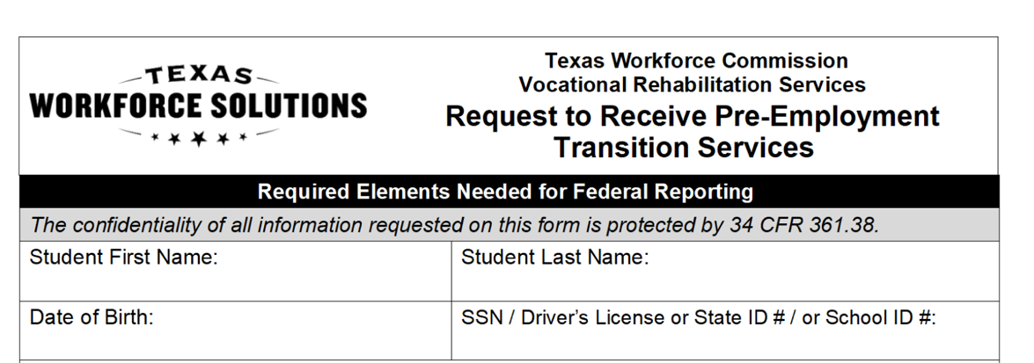
Potentially Eligible Process
Counselor drives the process and completes VR1820 Request for Pre-ETS form for each student requiring only Pre-Employment Transition Services. Social security number is preferred but other unique identifiers such as State ID or School ID number can be used. Parent or Guardian must sign 1820 form if student is underage.
Counselors and school staff can work together to get the 1820 forms signed by the student/parent and returned to VR Counselor.

Slide 22
Potentially Eligible Cases: Required Documentation To Verify Disability (Policy Reference: VRSM Part C – Chapter 8.1 Pre-ETS)
Supporting documentation that is required to verify the student's disability may include the following:
Case notes documenting VR counselor observations, review of school records, and statements of education staff;
A signed statement from a school professional with the identification of a student's disability and school enrollment status (A template of the VR Disability Verification Letter is available on the Transition Intranet Page);

Slide 23
Potentially Eligible Cases: Required Documentation To Verify Disability (Policy Reference: VRSM Part C – Chapter 8.1 Pre-ETS) – Continued
A copy of an IEP, Social Security Administration (SSA) beneficiary award letter, school psychological assessment, documentation of a diagnosis or disability determination, or documentation relating to Section 504 accommodations.
Note for VR Staff: Do not use an Eligibility Case Note to document disability for a Potentially Eligible Case. Refer to the new Desk Aide: How to Document a Potentially Eligible Case for guidance regarding how to document a Potentially Eligible case in Rehab Works.

Slide 24
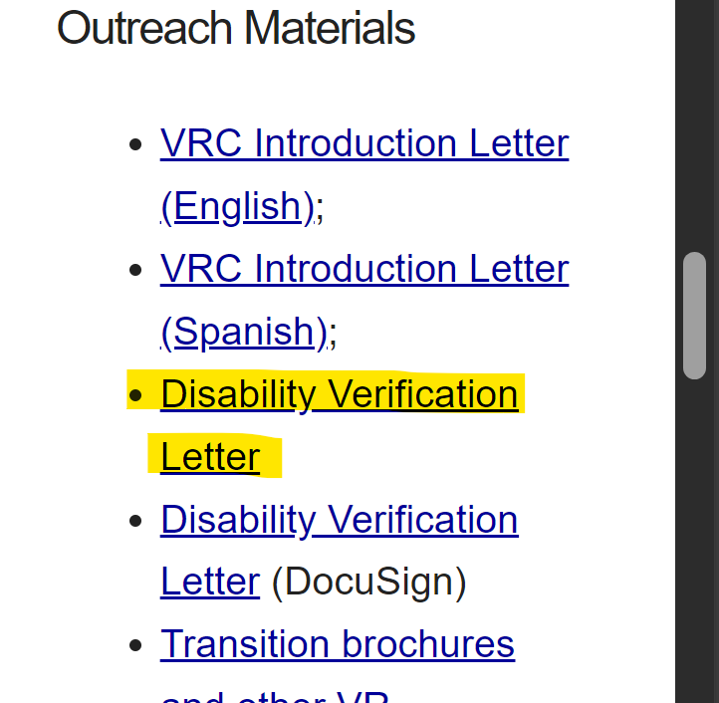
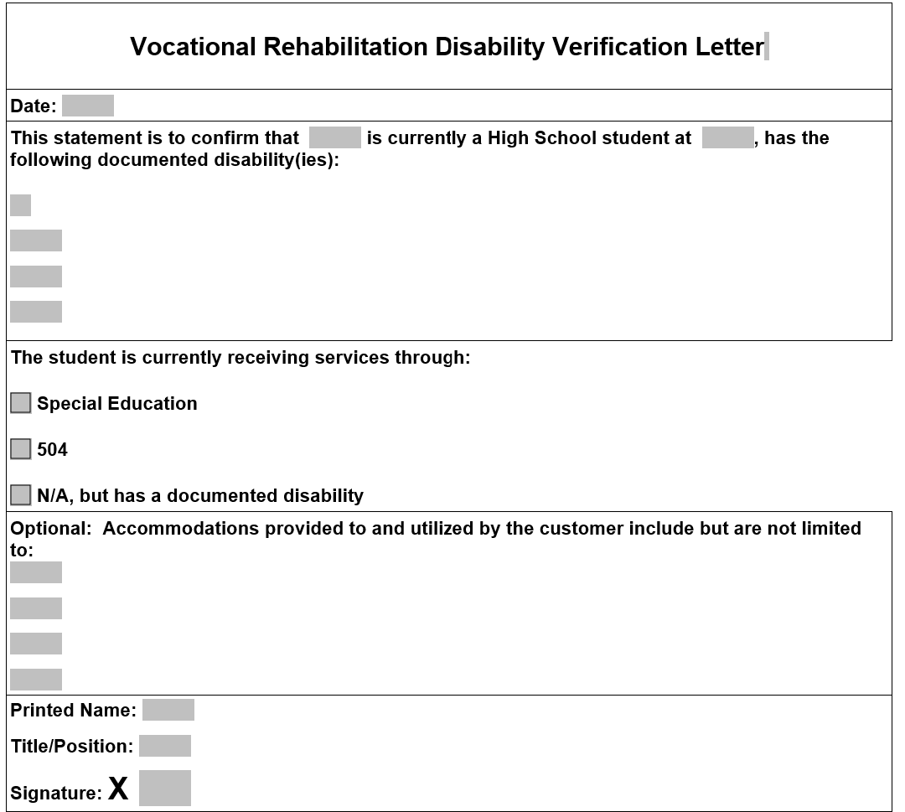
VR Disability Verification Letter on TWS-VRS Transition Intranet Page

Slide 25
Starting The Potentially Eligible Process
Applicable releases are required to share information with school, and parental/guardian consent is required if student is a minor.
  VR5061 Notice and Consent for Disclosure of Personal Information (required)
  VR1517-2 Authorization for Release of Confidential Customer Records and Information for Parents (if the student is not a minor)
  VR1517-2 Authorization for Release of Confidential Customer Records and Information for School (recommended by VR Policy to share information with school)
  VR5060 Permission to Collect Information (required if school records are requested)
For Work-Based Learning, VR staff asks the customer to provide original unexpired documents that prove his or her identity and show that the customer can work legally in the United States. Examples of work-based learning placement include:
  SEAL
  Placements through Paid or Unpaid Work Experience

Slide 26
Potentially Eligible Process (continued)
Counselors provide students with “Can We Talk” Brochure for informed choice and appeal procedures.
Counselor completes any needed Service Justification and Service Authorizations for services provided in PE phase.
Potentially eligible students may immediately engage in pre-employment transition services as well as apply for the full range of VR services.
Counselor documents case notes on customer progress in all Pre-ETS.
Counselor works with student/parents and Pre-ETS vendor to determine the need for additional Pre-ETS versus the need for additional supports and VR application.

Slide 27
Potentially Eligible Cases: Case Notes
Policy Reference:
VRSM Part C – Chapter 8.1 Pre-ETS
The TVRC or VR counselor assigned to the potentially eligible case must enter case notes in RHW that document information about the student, justification for services, progress, and outcomes. Topics that must be documented in one case or multiple case notes, when applicable, are:
  a description of the disability, functional limitations, and counselor observations; we should add corresponding case notes, as it can be confusing.
  a record of the disability from the student’s perspective;

Slide 28
Potentially Eligible Cases: Case Notes
Policy Reference: VRSM Part C –
Chapter 8.1 Pre-ETS(continued)
  counseling and guidance and other Pre-ETS provided directly by the VR counselor;
  a service justification case note that indicates the planned services, including the type of, and rationale for, Pre-ETS; and
  the skills gained, as well as other progress made by the student as a result of receiving Pre-ETS
  For More information on Pre-ETS case notes and activities, reference TWC Desk Aide for Potentially Eligible Vocational Rehabilitation Division: Transition Services for Students and Youth with Disabilities (texas.gov) and the new Desk Aide: How to Document a Potentially Eligible Case.

Slide 29

VR Process Timeline

Slide 30
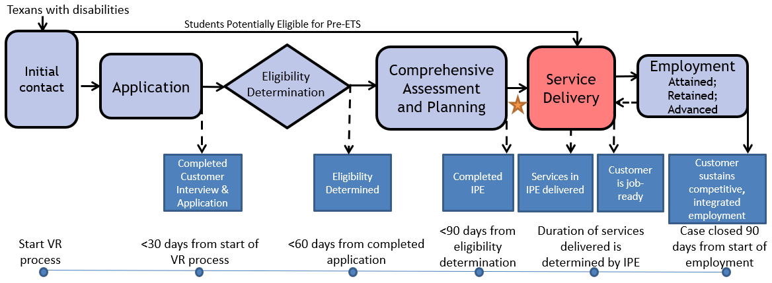
The VR Process and Timelines
30 → 60 → 90-day timelines

Slide 31
Common Forms and When to Use Them
VR5060 Permission to Collect Information | A customer authorizes VR to collect information or records from an individual or entity. A customer completes an application and: An individual at a 14c is interested in applying for VR services, VR is requesting records or information, or VR discloses records to a juvenile service provider. | The release is valid for 365 days from the date signed, or until the date when the VR case is closed, whichever date occurs earlier.
VR5061 Notice and Consent for Disclosure of Personal Information | A customer acknowledges that VR may need to disclose personal information or records to other organizations for purposes directly connected with the administration of their VR services. At application and initial contact without case assignment for potentially eligible. A customer’s file contains alcohol and drug abuse patient records. | No expiration

Slide 32
Common Forms and When to Use Them (Con’t)
VR2002 Referral Form | General Referral Form Does not require signature | No expiration
VR1820 Request to Receive Pre-ETS | Request for Pre-ETS services only Can serve as a referral form. Must be filled out prior to receipt of any Pre-Employment Transition Services. | No expiration; New form is not required each school year.
VR 1487 Designation of Representative | Needed for students that are underage or have a guardian | No expiration; Continues until counselor is notified in writing that it is no longer in effect.

Slide 33
Common Forms and When to Use Them (Continued )
VR1517-2 Authorization for Release of Confidential Customer Records and Information | A customer authorizes VR to release confidential records and information to a person(s) or entity. A customer with no guardian would like for a person that he chooses to be present during appointments with the VR counselor. A transition student would like his counselor to discuss his specific accommodation needs with potential employers. | The release is valid until revoked by the customer or until the date when the customer ceases to be a VR applicant or customer, whichever date occurs earlier.
VR 5063 Permission to Collect and Notice to Disclose - National Student Clearinghouse | The purpose of the VR5063 is to document a customer’s consent to exchange information with National Student Clearinghouse, a source that houses post-secondary student data. The credential information received from National Student Clearinghouse may be used to satisfy reporting and documentation requirements for federal performance measures related to credential attainment. | No expiration

Slide 34
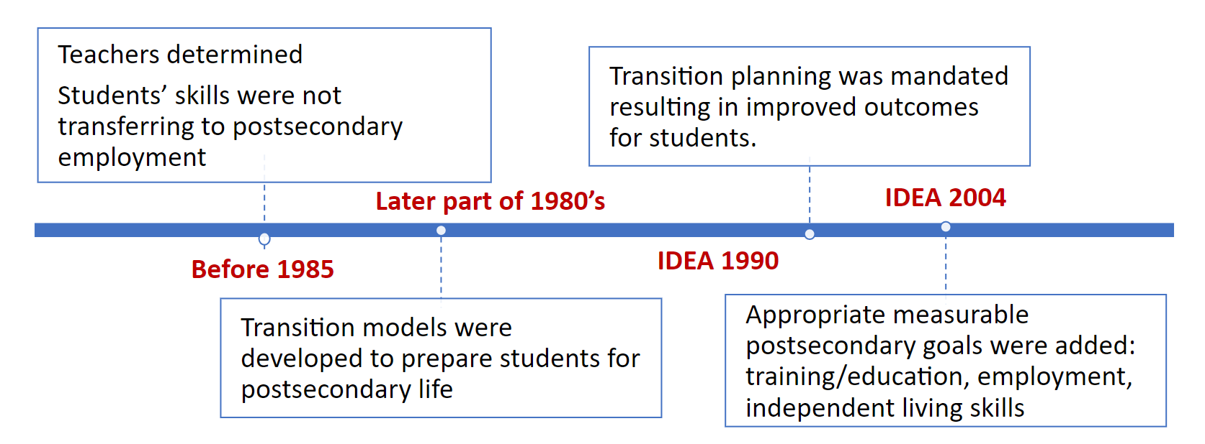
Why Collaboration – Look History of Transition
When transition becomes student-focused, instead of the professional’s focused post-school outcomes improve.
This mindset takes collaboration between all stakeholders.
Relationships
Communication
Supports

Slide 35


Building Confidence
Questions
Students need to believe in themselves
What are my strengths?
What are my preferences?
Think about-----
Don’t let the student’s disability define themselves.
What are my interests?
What are my needs?

Slide 36
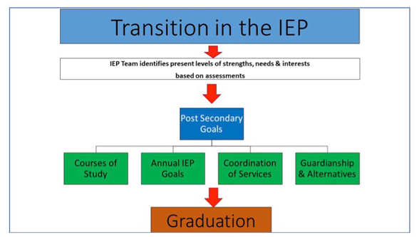
The ARD - 1
STAAR/EOC
Accommodations
Modifications
Schedule of Services
Results of progress monitoring
TWS-VR

Slide 37

The ARD - 2
Remember transition is about the student
    Make the ARD meaningful for the student
    Make the TWS-VR experience meaningful

Slide 38
State Performance Plan Indicator (SPPI) 13
TEA’s State Performance Plan Indicator (SPPI) 13 measures the percent of youth with IEPs aged 16 (soon to be revised to age 14) and above with an IEP that includes:
Appropriate measurable postsecondary goals that are annually updated and based upon an age-appropriate transition assessment;
Transition services, including courses of study, that will reasonably enable the student to meet those postsecondary goals; and
Annual IEP goals related to the student's transition services needs.
There also must be evidence that the student was invited to the admission, review, and dismissal (ARD) committee meeting where transition services are to be discussed and evidence that, if appropriate, a representative of any participating agency that is likely to be responsible for providing or paying for transition services was invited to the ARD meeting with the prior consent of the parent or student who has reached the age of majority.

Slide 39
SPPI 14
TEA’s SPPI 14 survey provides a clear measure of post-school outcomes for youth with disabilities as they transition from high school to adult life. The survey results are submitted to the Office of Special Education Programs (OSEP) and include data about the percent of youth who are no longer in secondary school, had IEPs in effect at the time they left school, and were enrolled in higher education, competitively employed, enrolled in other postsecondary education or training programs, or engaged in other types of employment within one year of leaving high school.
To conduct this data, a survey is conducted one year after the cohort of students left school. Exited students are contacted through phone calls, text messages, email, and postcards.

Slide 40
TEA’s Cyclical Monitoring
State education agencies have a responsibility under federal law, to establish a system of general supervision that monitors local education agencies' (LEA) implementation of the Individuals with Disabilities Education Improvement Act (IDEA) of 2004. The Texas Education Agency (TEA) is accountable to monitor local education agencies (LEAs) to ensure compliance with federal and state regulations and to improve services and results for students with disabilities.
The comprehensive cyclical monitoring review includes different monitoring activities to evaluate the LEA’s special education program and dyslexia program. Monitoring activities focus on seven state-identified priority areas and may include but are not limited to a desk review (i.e., policy review and folder review), on-site campus review, and stakeholder feedback:
● Child Find/Evaluation/FAPE
● IEP Development
● IEP Content
● IEP Implementation
● State Assessment
● Properly Constituted ARD
● Transition

Slide 41
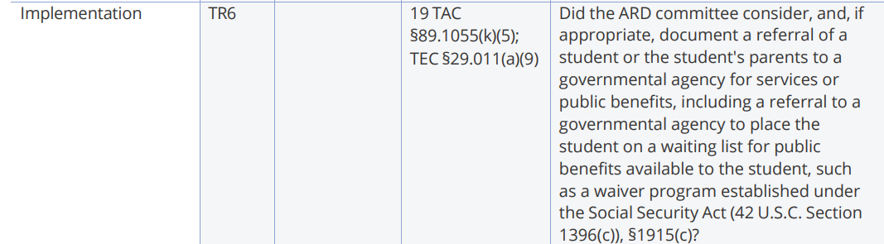
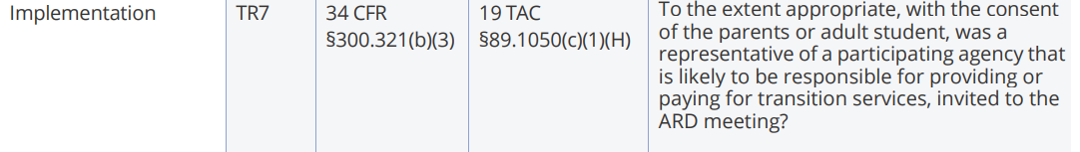
TEA’s External Desk Review Rubric – Updated: August 2024

Slide 42
TEA’s Cyclical Monitoring Schedule
Cyclical Monitoring Schedule, Cycle 6, 2024-2025
Cyclical Monitoring Schedule, Cycles 1-6, 2025-2031

Slide 43

Questions

Slide 44
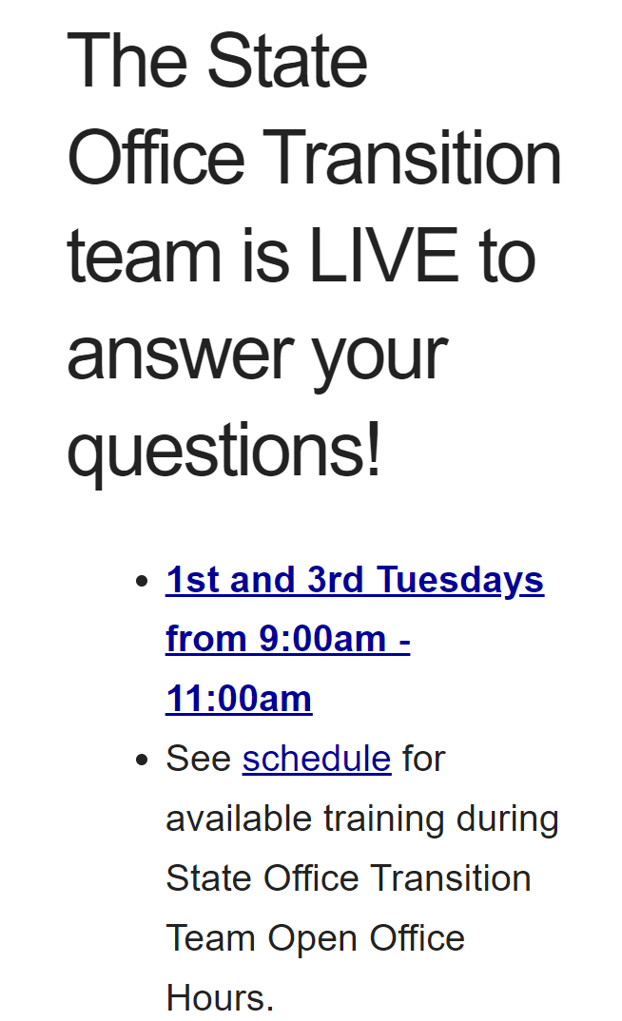
Contact Information and
Pre-ETS Office Hours
VR Pre-ETS Mailbox
VR.Pre-ETS@twc.texas.gov

Slide 45
Use AskTED ESC Search Screen (state.tx.us) to find your Educational Service Center Contacts

Slide 46
Regional Transition Specialists
Region 1 West Texas Andrew Castillo 915-834-7701 Andrew.Castillo@twc.texas.gov | Region 3 Central Texas Judy Siebel 512-820-1765 Judy.Siebel@twc.texas.gov | Region 5 Houston Janeen Gordon 832-840-2946 Janeen.Gordon@twc.texas.gov
Region 2 Dallas/Ft Worth Rosla Hocker 817-436-4127 Rosla.Hocker@twc.texas.gov | Region 4 East Texas Kirstin Johnson 903-504-9531 Kirstin.Johnson@twc.texas.gov | Region 6 South Texas Rebecca Quintero 210-238-3592 Rebecca.Quintero@twc.texas.gov

Slide 47
State Office Transition Team
Erin Wilder Program Manager 512-936-3707 Erin.Wilder@twc.texas.gov | Kevin Markel Program Specialist 817-727-9045 Kevin.Markel@twc.texas.gov | Alyssa Kee Program Specialist 915-217-8188 Alyssa.Kee@twc.texas.gov | Kristen Davis Program Specialist 512-221-9071 Kristen.Davis@twc.texas.gov
Laura Villarreal Neurodevelopmental Specialist 512-541-6439 Laura.Villarreal@twc.texas.gov | Leigh Ann Godinez Program Specialist 512-720-8347 Leighann.Godinez@twc.texas.gov | Gabriela Martinez Program Specialist 956-566-1228 Gabriela.Martinez@twc.texas.gov | Team Mailbox VR.Pre-ETS@twc.texas.gov

Slide 48
Texas Workforce Solutions-Vocational Rehabilitation Services
101 East 15th Street
Austin, Texas 78778-0001
512-936-6400
VR.office.locator@twc.state.tx.us
Equal Opportunity Employer/Program
Auxiliary aids and services are available upon request to individuals with disabilities.
The Texas Workforce Commission accepts calls made
through any relay service provider.
www.twc.texas.gov

Slide 49
Federal Funding
These activities are financed under the TWC Federal Vocational Rehabilitation grant. For the Federal fiscal year 2024 (October 1, 2023, through September 30, 2024), TWC anticipates expending $320,291,817 in Federal Vocational Rehabilitation funds. Funds appropriated by the State pay a minimum of 21.3% of the total costs ($86,686,349) under the Vocational Rehabilitation program. Revised June 2024.
For purposes of the Supported Employment program, the Vocational Rehabilitation agency receives 94.7 percent of its funding through a grant from the U.S. Department of Education. For the 2024 Federal fiscal year, the total amount of grant funds awarded are $1,501,230. The remaining 5.3 percent ($83,402) are funded by Texas State Appropriations. Revised June 2024.
For purposes of the Independent Living Services for Older Individuals who are Blind program, the Vocational Rehabilitation agency receives 90 percent of its funding through a grant from the U.S. Department of Education. For the 2024 Federal fiscal year, the total amount of grant funds awarded are $2,213,488. The remaining 10 percent ($245,943) are funded by Texas State Appropriations. Revised June 2024.

