Slide 1
Roles of TWC Transition Vocational Rehabilitation Counselor in Collaboration with Schools - A Panel Discussion
Jenna Shane Page, TWC Transition Vocational Rehabilitation Counselor (TVRC)
Lana Arthur, TWC Vocational Rehabilitation Counselor (VRC)
Sam Gonzalez, ESC 20 Transition Consultant

Slide 2
Roles and Responsibilities
Explain your primary responsibilities as a TVRC/VRC including how many schools you support.

Slide 3
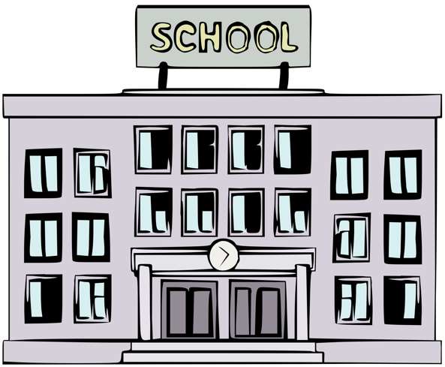
A typical day in the life of a VR Counselor
Can you walk us through a typical day in your role as a TVRC/VRC? How do you prioritize your time and plan visits to the schools to collaborate with school districts and serve students with disabilities?

Slide 4
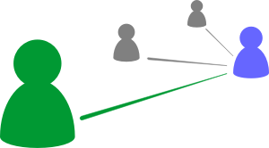
Making Connections
As a TVRC/VRC, how do you connect with students with disabilities outside of Special Education? For example, 504 and CTE Students, younger students, and students who visit the school nurse for specific medical conditions.

Slide 5
Challenges
What common communication and/or collaboration barriers do you face when partnering with ISDs, and how do you overcome them? For example, changes in staff, policy and procedures.

Slide 6
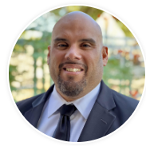
Meet Sam Gonzalez from ESC Region 20
Transition Consultant
Samuel.Gonzalez@esc20.net

