Slide 1
Blazing a Trail
The Capacity-Building Project’s Collaborative Effort to Expand Pre-ETS Services for Younger Teens

Slide 2
Rationale:
Memorandum of Understanding (MOU)
To increase coordination between the Texas Education Agency (TEA), Texas Workforce Commission (TWC) and Local Education Agencies (LEAs) to identify and prepare students with disabilities to move to postsecondary education and/or competitive integrated employment.
To improve transition planning by Vocational Rehabilitation (VR) staff and LEAs for students with disabilities to facilitate the development and implementation of the Individualized Education Program (IEP).
To establish and periodically update a mechanism to identify the areas of the state with the greatest needs for VR transition services for students with disabilities.

Slide 3
Rationale: MOU (continued)
To institute mechanisms to ensure VR staff can attend ARD meetings when invited and as appropriate.
To clarify each party’s roles and responsibilities, including financial responsibilities.
Strengthen relationships between TEA, TWC, Education Service Centers (ESCs), LEAs, higher education entities, and businesses to facilitate successful outcomes for students with disabilities.

Slide 4
Rationale: Findings from Research
In Texas: Individuals with disabilities represented only 6% of people employed (Texas Workforce Investment Council, 2016).
Evidence-based practice to prepare for transition to employment: (Bellman et al., 2014; Lee & Carter, 2012)
Early experiences
Supported internships
Collaboration

Slide 5
Eight Substantiated Practices
(Landmark, Ju, & Zhang, 2010)

Slide 6
The transition taxonomy
(Kohler et al., 2016)

Slide 7
Interagency Collaboration
Community support providers
Education
agencies
Families
Agencies outside school
Transition planning
Holistic and supportive transition plan
Meaningful employment exploration opportunities

Slide 8
GO TEXAS!
Texas is the first to engage in statewide capacity building to realize the goal of the MOU by funding a series of three-tier capacity building activities.
We are proud that the Center on Disability and Development at Texas A&M is entrusted with the tasks of implementing these activities.

Slide 9
Purpose: Capacity Building Project
To enhance interagency collaboration, especially between schools and workforce commission.
Provide real-life and virtual platforms for networking and team building activities during and after the conference,
Feature both national and local experts who will help us engage in evidence-based and best practices,
Offer a variety of tools and perspectives that will broaden our vision and enhance our practices, and
Culminate with group activities to develop goals at the regional and local levels.
Our hope is this work would sustain your zeal and love for transition services in Texas.
Interagency Collaboration is CRITICAL for increasing postsecondary employment outcomes

Slide 10
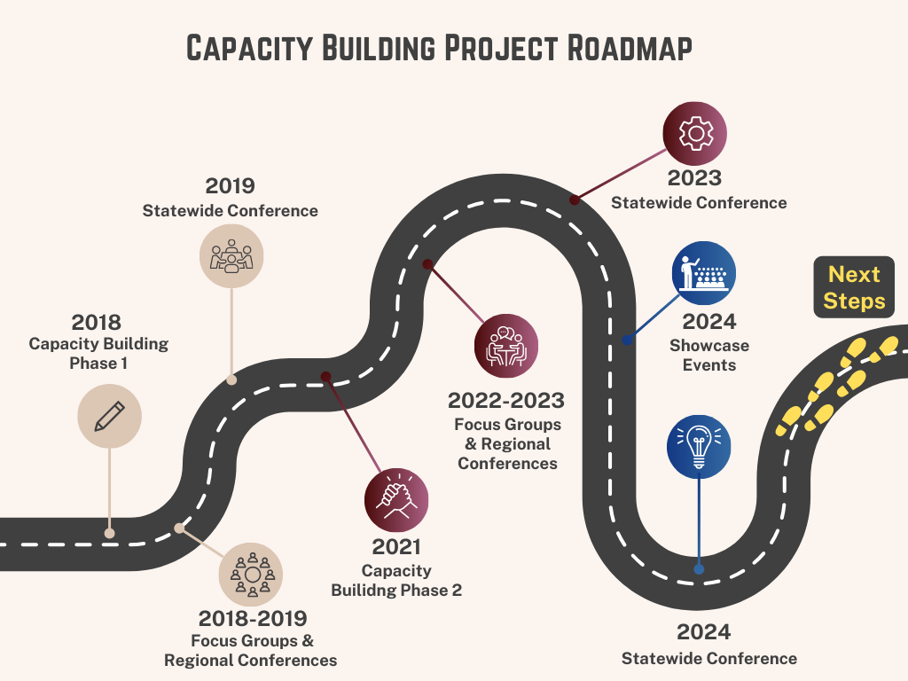
Capacity Building Project Roadmap

Slide 11
Capacity Building: Phase 1
Regional Conferences (6)
Training
Statewide Conference (1)
Focus Groups (8)
iGROW Project
Projects and Products
Work-Based Learning Project
Pre-ETS Guide
Your input paved the way.

Slide 12
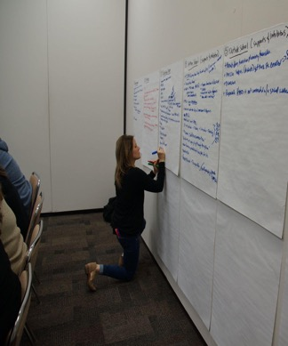
Phase 1: 8 Focus Groups
Recognized need for increased collaboration
When collaboration was possible, co-workers and external providers served as great resources
Need: additional training & education for all stakeholders
Barriers to collaboration
Access to the community they served
Limitations on time for training, collaboration, and access
Communication challenges (including language and trust)

Slide 13
Phase 1: 6 Regional and 1 Statewide Conferences
What Did We Learn?
Take Action!
Each other’s roles, expectations, and obstacles
We share the same goals
Communication and collaboration is important
Varieties of resources
Set up meetings between VR counselor and schools
Share the information and plans
Implement the plan
Over 20 Transition Teams were created!

Slide 14
Collaborative Teams Formed in Phase 1
The Flying Chanclas
The Bushwhackers
Team FUN (Fulfillment, Utilizing Networking)
The Possibilitarians
Team L.O.S.T.
The Collaborators
Triple T (Terrific Transitional Team)
Lucky “7”
Shooting Stars
Triple C (Cooperative Collaborating Champions)
The Transitionators
Team Skippy
Life Builders
Houston Hurricanes
Texas Takeovers
Connecting Playmakers
Improvement Specialists
Dream Breakers
“We’re Number 1!”
The Core 5
Endless Opportunities
Retro R&B
The Fantastic 4’s
Team Trinity
Team ‘RGV’
Trans-Informers
The Fab 5
The Great 8
The 7 Ups
The Commuting Avengers

Slide 15
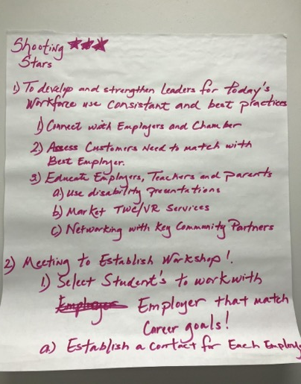
Phase 1 Outcome: Transition Teams
Set Goals
Implement
Educating and involving parents
Improve referral process
Create a communication system between stakeholders
Create a transition timeline
Build relationships with the VR counselors
Increase community relations
Set up parent meetings

Slide 16
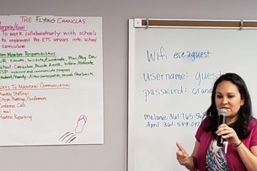
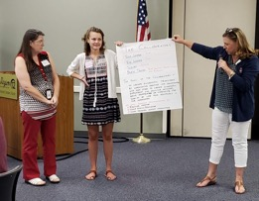
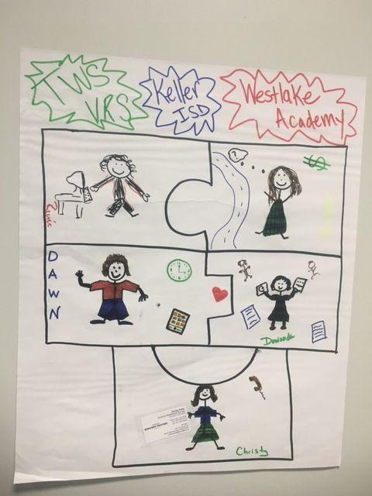
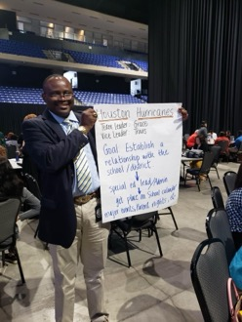
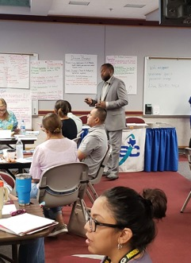
Collaborative Teams in Action
Collaborative teams in action

Slide 17
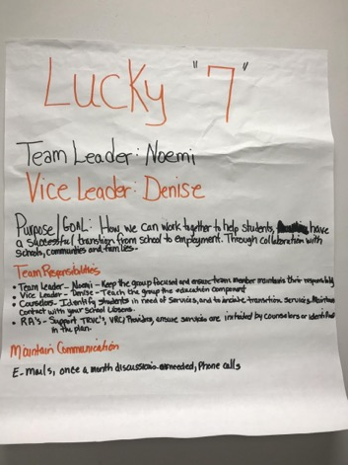
Phase 1 Outcome: Transition Teams
Phase 1 Outcomes
Identify
Additional Support Areas
More regular meetings
Presenting together at Texas Transition Conference
Parent and student event
Educating parents
Family support
Understanding of how TWC can support

Slide 18
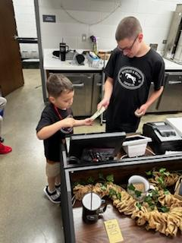
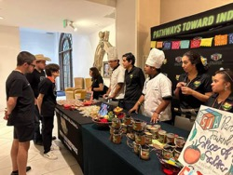
Phase 1 Outcome: Collaborative Service Delivery Models
Work-based Learning (WBL) Project
Focus group data and conference discussions identified a need for work-based learning opportunities. A pilot project was conducted to develop a service delivery model.
89 WBL Projects have been funded across the state
Over 2,000 high school students involved in work-based learning activities
170+ teachers trained
Notes:
TWC see the need to fund this project (WBL) and collaborate with CDD considering our knowledge and previous experience

Slide 19
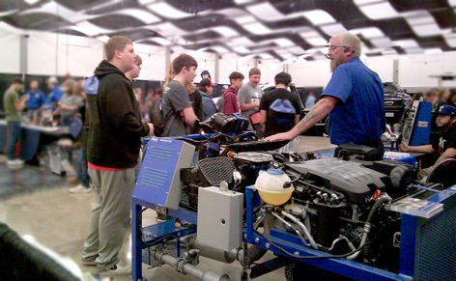
Phase 1 Outcome: Collaborative Service Delivery Models
i Generate Rural Opportunities for Work (iGROW)
Phase 1 data indicated that rural communities continue to be underserved.
92 high school students living in rural communities now have access to Pre-ETS and/or other VR services!
36 interagency team members from school districts and TWC-VR
Notes:
TWC see the need to fund this project (WBL) and collaborate with CDD considering our knowledge and previous experience

Slide 20
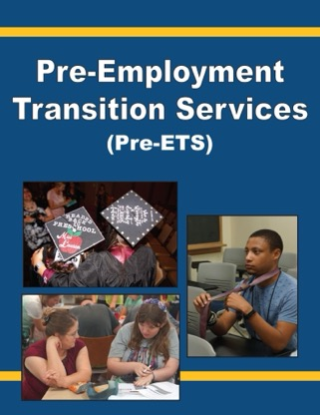
Phase 1 Outcome:
Pre-Employment Transition Services (Pre-ETS) Catalog
The Center on Disability and Development collaborated with TWC to develop the Pre-ETS Catalog, a guide to:
Pre-ETS eligibility and applying for services
Service coordination
Planning and implementation
Pre-ETS categories
Benefits to students
Benefits to employers
Resources for each Pre-ETS category

Slide 21
Rationale for Capacity Building Phase 2
Effective transition planning needs to start early:
Phase 2 has focused on identifying and addressing barriers to serving 14-to-16 year-old students.
Having formed collaborative teams in Phase 1, the purpose of Phase 2 was to equip those teams to provide Pre-ETS services to younger teens as outlined in the Workforce Opportunity and Innovation Act (WIOA).

Slide 22
Capacity Building: Phase 2
Statewide Conferences (2)
Training
Regional Conferences (6)
Focus Groups (6)
Highlighted Best Practice
Showcase Events (12)
Provided Technical Assistance
Your examples shaped practice.

Slide 23
Phase 2: 6 Focus Groups
The level of parent involvement as a significant determinant for VR and ISDs to collaboratively deliver Pre-ETS to students with disabilities, ages 14-16
Challenges with parent involvement:
SES of the family
Fear of losing benefits
Parents are already overwhelmed
Language and culture barriers
Lack of knowledge about TWC, Pre-ETS, student’s disability, and the service/support available
Early intervention is necessary.

Slide 24
Phase 2: 6 Focus Groups
Younger students’ lack of disability awareness, self-determination, and self-advocacy skills
Potential causes:
Parents often resist telling their students about their disabilities, which increases the stigma when the disability is disclosed.
Students are not given opportunities to understand why they have classroom accommodations and how those accommodations will translate to the workplace.
VR Counselors become the “dream killers” and students may refuse VR services.

Slide 25
Phase 2: 6 Focus Groups
Limited opportunities to provide Pre-ETS to students with disabilities, ages 14-16, during the school day
Possible causes:
Misconceptions about school personnel roles and responsibilities
Lack of understanding on the impact of TWC/ISD collaboration in providing Pre-ETS for younger students with disabilities
Transportation/capacity to participate in Pre-ETS outside of school

Slide 26
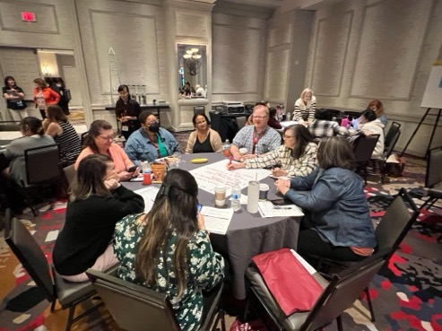
Regional Conferences
Created opportunities to learn about each other’s systems and procedures
Highlighted outstanding school-VR teams
Addressed barriers to Pre-ETS service delivery through collaborative teaming
Provided training on transition assessment and best practices

Slide 27
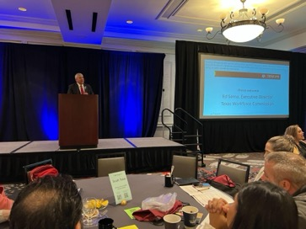
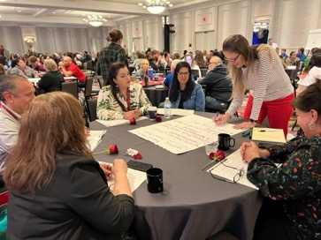
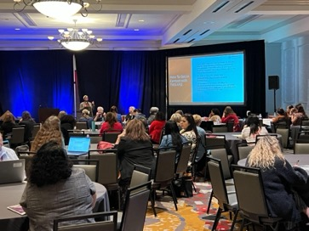
2023 Statewide Conference
5 keynote + 18 Breakout Sessions
Addressing needs identified by focus groups and regional conference attendees
Opportunities to collaborate and plan implementation of new approaches to serving younger teens

Slide 28
Regional and Statewide Conferences
Most helpful to the conference participants:
Collaboration, networking with local schools and VR counselors
Learning about the work of other school districts
New themes:
Transition assessments
Learning about iGROW/resources for rural areas
Learning about the Work-Based Learning Project

Slide 29
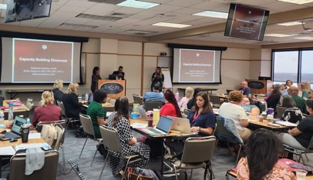
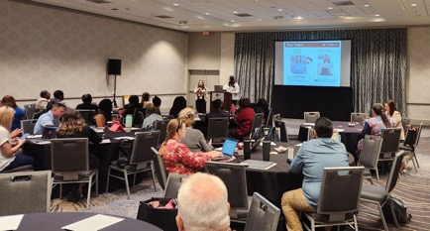
Showcases
Regional showcases provided practical strategies to address the barriers identified by focus groups and highlighted innovative approaches to serving younger teens.

Slide 30
Taken Together
Collaboration and communication between schools and VRs have been improving AND remain as ongoing challenges
78% of survey respondents report increased collaboration , but this is still seen as an ongoing need
Roles are more defined, which helps identify who to contact
Increasing awareness to identify and involve students

Slide 31
Ongoing Challenges
Communication and collaboration
Lack of staff and frequent turnover
High case load of VR counselors
More staff needs in rural areas
Continued emphasis on older high school students

Slide 32
Ongoing Challenges
TWC
Parental involvement and understanding
School schedule and access to students
Competing priorities and limited VR resources
Educators
Limited staffing and resources
Communication with TWC
Parental involvement

Slide 33
Continued Training Needs
Streamlining the VR application process and improve the communication about timelines for students and educators
Early intervention strategies for students of 14-16 years old, smoother VR service integration
Enhancing communication and collaboration with educators
Working with parents: best practices to build trust and collaborate

Slide 34
Thanks to
TWC’s Leadership
and the
State Office Transition Team

Slide 35
Thanks to
TWC Regional Directors, Deputy Regional Directors, Program Specialists
and
ESC Transition Specialists

Slide 36
Thanks to
Our Focus Group Participants

Slide 37
Thanks to our
Regional Conference Presenters and Panelists

Slide 38
Thanks to our
Regional Showcase Presenters

Slide 39
Thanks to our
Statewide Conference Presenters

Slide 40
And Thanks to All of You
for Your Dedicated Service to our Transition-Aged Youth!

